Slide 1
Pre Eclampsia and Eclampsia (PE/E): Mitigating the impact on maternal and perinatal health in LMICS
Prof Jamilu Tukur
Provost, CHS Umaru Musa Yaradua University/ Consultant Obgyn, Federal Teaching Hospital, Katsina

Slide 2
Outline
Introduction
Impact of PE/E to maternal and perinatal morbidity and mortality in LMICS
Comparison of PE/E presentations
Mitigating the impact of PE/E
Way forward
Conclusion

Slide 3
Introduction
In the fifth century, Hippocrates noted that headaches, convulsions, and drowsiness were ominous signs associated with pregnancy.
In 1619, Varandaeus coined the term eclampsia

Slide 4
Introduction
Eclampsia is defined as new onset of generalised tonic clonic seizure activity and/or unexplained coma during pregnancy or postpartum in a woman with signs or symptoms of preeclampsia.

Slide 5
Introduction
Preeclampsia is defined as new onset rise in blood pressure recorded in the second half of pregnancy with or without proteinuria and coexisting systemic abnormalities.

Slide 6
Introduction
Other than early detection of preeclampsia, no reliable test or symptom complex predicts the development of eclampsia
ANC is paramount for early detection
Main treatment revolves around delivering the baby

Slide 7
Diagnosis of PE

Slide 8
LMIC
Defined by the World Bank as lower middle income economies- those with a GNI per capita between $1,036-$12,535.00.
Have low or middle income
Home to 75% of world population
62% of the World’s poor
Countries:
Afghanistan
Bangaladesh
Bhutan
Chad
Nigeria

Slide 9
Eclampsia and maternal/fetal morbidity and mortality
With the greatest morbidity and mortality, preeclampsia affects 5% to 7% of all pregnant women but is responsible for over 70 000 maternal deaths and 500 000 fetal deaths worldwide every year
Rana S. Preeclampsia: Pathophysiology, Challenges, and Perspectives. Circulation Research 2019; 124(7): 2-5

Slide 10
Eclampsia and maternal/fetal morbidity and mortality
In developed countries, the maternal death rate from PE/E is reportedly 0-1.8%.
The perinatal mortality rate from eclampsia in the United States and Great Britain ranges from 5.6% to 11.8%.
The maternal mortality rate is as high as 14% in LMIC countries

Slide 11
Eclampsia and maternal/fetal morbidity and mortality
A study from the US Centers for Disease Control and Prevention (CDC) found an overall preeclampsia/eclampsia case-fatality rate of 6.4 per 10,000 cases at delivery.
The study also found a particularly high risk of maternal death at 20-28 weeks’ gestation
Source: MacKay AP, Berg CJ, Atrash HK. Pregnancy-related mortality from preeclampsia and eclampsia. Obstet Gynecol. 2001 Apr. 97(4):533-8

Slide 12
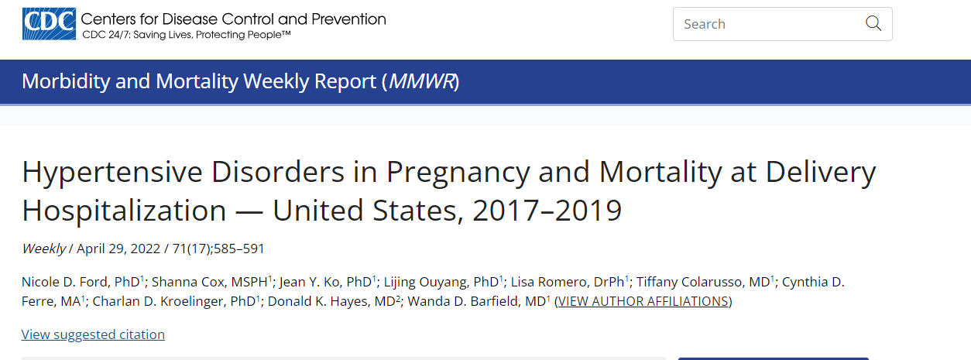
Eclampsia and maternal/fetal morbidity and mortality
Black woman have twice the risk that white women have for mortality associated with preeclampsia/eclampsia.

Slide 13
Eclampsia and maternal/fetal morbidity and mortality
The fetal mortality rate varies from 13-30% due to premature delivery, Placental infarcts, abruptio placentae, intrauterine growth retardation, and fetal hypoxia also contribute to fetal demise
Source: Gabbe. Obstetrics: Normal and Problem Pregnancies. Hypertension. 5th ed. Churchill Livingstone, Elsevier; 2007

Slide 14
Eclampsia and maternal mortality in Nigeria
Center | Year | Case fatality | Perinatal mortality | Reference
Kano | 2011 | 5.2% | 13.2% | Gaya and Yakasai. Ann Afr Med 2011
Port Harcourt | 2020 | 7.8% | 14.4% | Awoyesuku PA et al. Int J Rep Contr Obs Gynaecol 2020
Sagamu | 2020 | 4.4% | 8.9% | Odelola Et al. Nig J Med 2020
Abuja | 2022 | 3.9% | 10.7% | Akaba GO et al. Clinical Hypert 2021

Slide 15
Eclampsia and maternal mortality in Nigeria
CENTER | YEAR | No of births | No of maternal deaths | MMR/100,000 live births | CONTRIBUTION OF ECLAMPSIA TO MATERNAL MORTALITY | RANK OF ECLAMPSIA IN MATERNAL DEATHS | REFERENCE
Birnin Kudu | 2007 | 2197 | 51 | 1001 | 43.1% | 1st | Tukur J et al. Annals of Afr Med 2007
Kano | 2011 | 13,943 | 126 | 904 | 28.5% | 1st | Gaya and Yakasai. Ann Afr Med 2011
Abakaliki | 2013 | 12,587 | 171 | 1359 | 6.1% | 6th | Ezegui et al. Ann Med Health Sc Research 2013
Fed Teaching Hospitals in Nigeria | 2015 | 91,724 | 998 | 1088 | 21.3% | 1st | Oladapo et al . BJOG 2015
Fed Teaching Hospitals in Nigeria | 2022 | 76, 563 | 940 | 1361 | 20.6% | 1st | Tukur J et al. E clinical Medicine 2022

Slide 16
Control and prevention of eclamptic fits
Currently available evidence supports MgSO4 as the best agent

Slide 17
Aptly demonstrated in Kano
 | Year | Case fatality from Eclampsia
Before MgSO4 | 2009 | 20.9
After MgSO4 | 2010 | 2.3
Tukur J et al. Maternal and Fetal Outcomes After Introduction of Magnesium Sulphate for Treatment of Preeclampsia and Eclampsia in Selected Secondary Facilities: A Low-Cost Intervention. Matern Child Health J (2013) 17:1191-1198 DOI 1007/s10995-012-1105-9

Slide 18
Issues related to MgSO4
Availability
Training
Administration of right doses
Monitoring for toxicity
Availability of antidote

Slide 19
Comparison of Eclampsia: Developed Vs Developing Countries
UK
Nigeria
Douglas KA, Reidman CWG. Eclampsia in the United Kingdom. BMJ 1994; 309 doi: http://dx.doi.org/10.1136/bmj.309.6966.1395

Slide 20
Comparison of eclampsia in different countries
 | UK | Abuja, Nigeria
Prevalence | 383/774436 (0.05%) | 257/22945 (1.1%)
Not attended ANC | 3% | 90.5%
Occurrence of first fit at home | 23% | 92.6%
Commonest eclampsia type | Postpartum 44% | Antepartum 67.6%
Maternal death | 7 (1.8%) | 11 (4.6%)
Still births | 9 (2.3%) | 28 (10.8%)

Slide 21
Eclampsia in the US
1,590,563 with 2955 (0.19%) eclampsia. Of these, 53.5% were intrapartum 45.8% postpartum. Women with readmissions for eclampsia were older, delivered earlier and more likely to have a cesarean delivery or multiple gestation

Slide 22
PE/E: developed countries
Decline of eclampsia
Transport
ICU care
Availability of drugs
Staffing
Eclampsia is reportable
Prevention

Slide 23
PE/E: LMIC countries
Quality and availability of ANC
Poverty
Illiteracy
Transport
Shortage of human resource for health
Availability of drugs
Myths and misconceptions

Slide 24
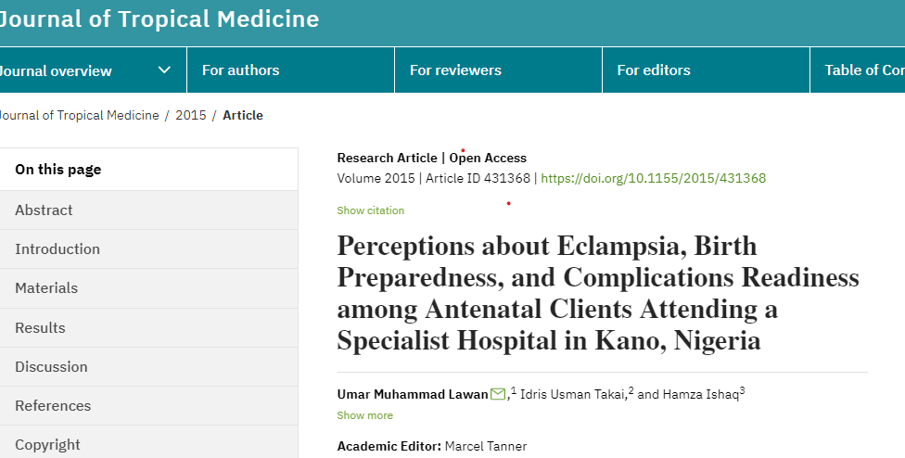
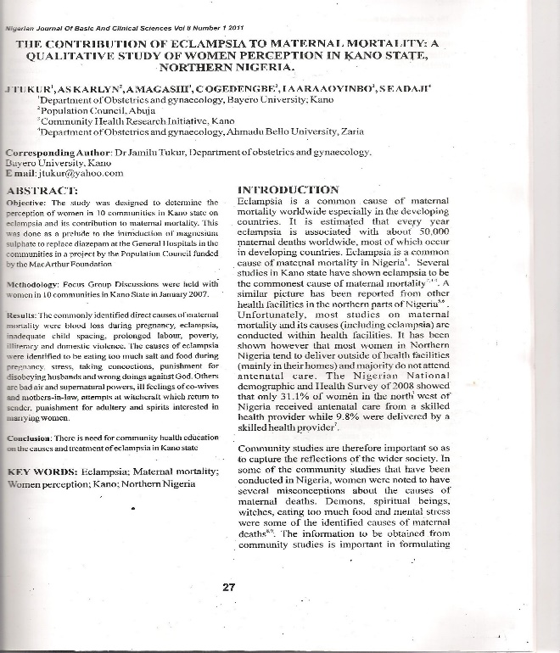
Myths and misconceptions on eclampsia
29.6% and 6.0% claimed that it is best managed through spiritual means/seeking for divine intervention or through a combination of hospital care and divine intervention/spiritual
it is inflicted upon the clients by evil spirits (18.8%)
Witchcraft
Evil spirit
Magic from co-wife etc

Slide 25
STATE | ANC by skilled Provider % * | BP measured at ANC%* | % PHCs with functional basic equipment*** | Delivery in a health facility %* | % delivery assisted by a skilled birth attendant**
Jigawa | 78.6 | 95.6 | 47.1 | 20.1 | 22.2
Yobe | 65.3 | 90 | 29.8 | 16.2 | 47.5
Kano | 64.3 | 89.2 | 1.5 | 19.2 | 27
Cross Rivers | 79.5 | 79.3 | 13.1 | 52.6 | 55.2
Anambra | 93.3 | 97.3 | 32.2 | 90.4 | 95.9
FCT | 87.7 | 96.5 | 49.4 | 63.2 | 63.2
Oyo | 85.4 | 98 | 21.9 | 70.1 | 82.4
Source:
*NDHS 2018, ** MICS Survey 2021, *** National Health Facility Survey 2016

Slide 26
Source: National Health Facility Survey 2016

Slide 27
Diagnostic accuracy
Source: National Health facility survey

Slide 28
Source: National Health Facility Survey 2016

Slide 29
Is there a way forward ?
YES

Slide 30
Community interventions
Nutrition for the girl child
Education
Family planning
Attendance/ Early booking at ANC
Availability of funds
Transport during emergencies
Avoiding 1st and 2nd delays

Slide 31
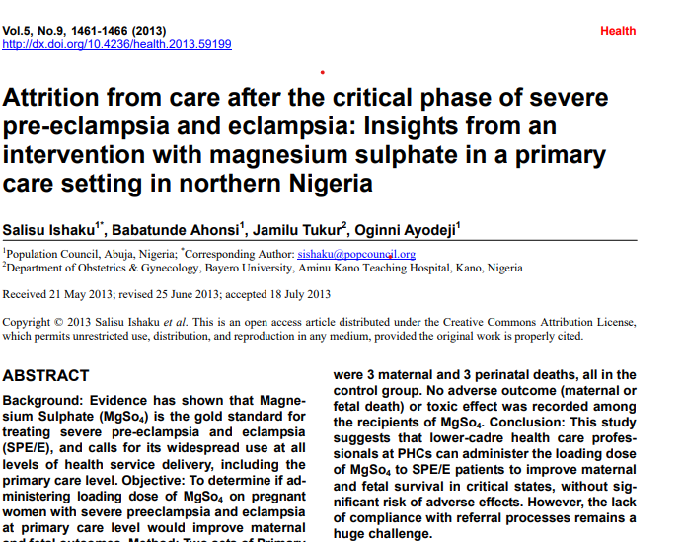
PHC
Loading dose of MgSO4 at PHC
Simplifies protocols
Salisu and Okusanya et al have demonstrated administration the feasibility of administration of loading dose at PHC

Slide 32
Ways to improve PE/E management: Facility level
Qualitative antenatal care
Delays: Transport, referral systems
Loading dose of MgSO4 at PHCs
Training on MgSO4/ Fluid Management
Eliminate stock out syndrome
High dependency units
? Task shifting
Community Health Education
Prevention of PE/E

Slide 33
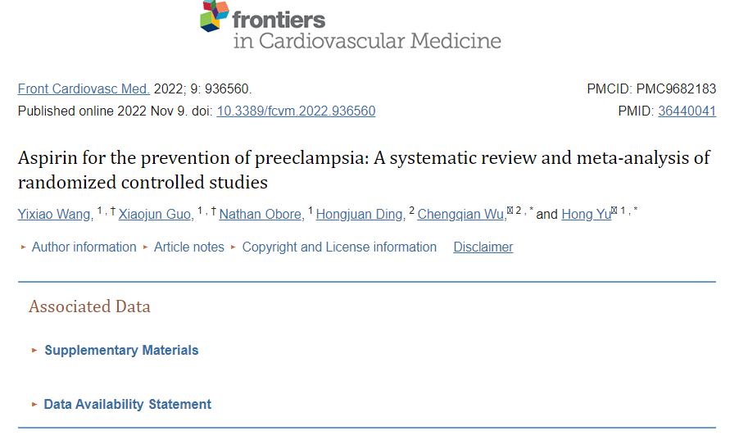
Prevention of PE/ E
Low-dose aspirin (81 mg/d) recommended in women at high risk of preeclampsia and should be initiated between 12 weeks and 28 weeks of gestation (optimally before 16 weeks) and continued daily until delivery.
Calcium supplementation in low dietary Ca
A systematic review recommends 75mg/D

Slide 35
Challenges with prevention of PE in LIMC
Late booking for ANC
Lack of awareness
Availability of medications
Universal aspirin?

Slide 36
Further research direction
Lots of attention on trace elements that have antioxidant activities
May explain why PE/E is common in LMICs
This includes calcium, magnesium etc
A lot of attention focused on selenium

Slide 37
Selenium and PE
Oxidative stress within the placenta one of the possible explanations for PE
Selenium is necessary for endogenous production of antioxidants
Significant serum reduction of selenium is associated with PE and other cardiovascular diseases
Its supplementation is associated with reduction in PE

Slide 38
Conclusion
High income countries seeing less PE/E
We need to educate our community and offer qualitative ANC
We should manage eclamptics using available evidence based clinical practice
Prevention and health education is key

