Slide 1
Diagnostic and Management Challenges for Fetal Congenital Anomalies in Nigeria
Dilly OC Anumba FWACS, FRCOG, MD, LL.M (Medical Law)
Professor of Obstetrics & Gynaecology
Consultant Obstetrician and Subspecialist in Maternal & Fetal Medicine
The University of Sheffield Medical School & Sheffield Teaching Hospitals
Sheffield, United Kingdom

Slide 2
Outline
Global epidemiology of fetal congenital anomalies (FCAs)
FCAs - African context
Management of FCAs – Health systems and service configurations
Challenges and opportunities in LMICs (Nigeria)
The role of Education and Training
Conclusion

Slide 3
Fetal congenital abnormalities (FCAs) – Epidemiology 1
Every year, ~7.9m children, 6% of all births worldwide, are born with a serious birth defect of genetic or partially genetic origin
~240,000 newborns die within 28 days annually from FCAs
170,000 child deaths aged 1 m - 5 yrs.
9 of 10 children born with a serious congenital disorder and 95% of deaths are in LMICs.
Contribute to lifelong mental, physical, auditory or visual disability, affecting individuals, families, health care systems and societies.
Contribute larger proportion of under-5 mortality with declining overall rates.
https://www.who.int/news-room/fact-sheets/detail/birth-defects

Slide 4
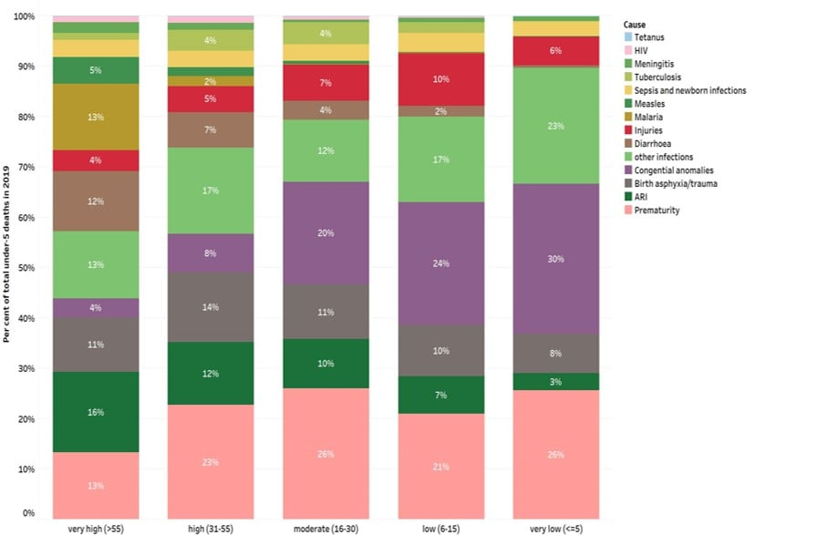
The proportion of under-5 deaths due to congenital disorders increases as other causes of under-5 deaths are controlled

Slide 5
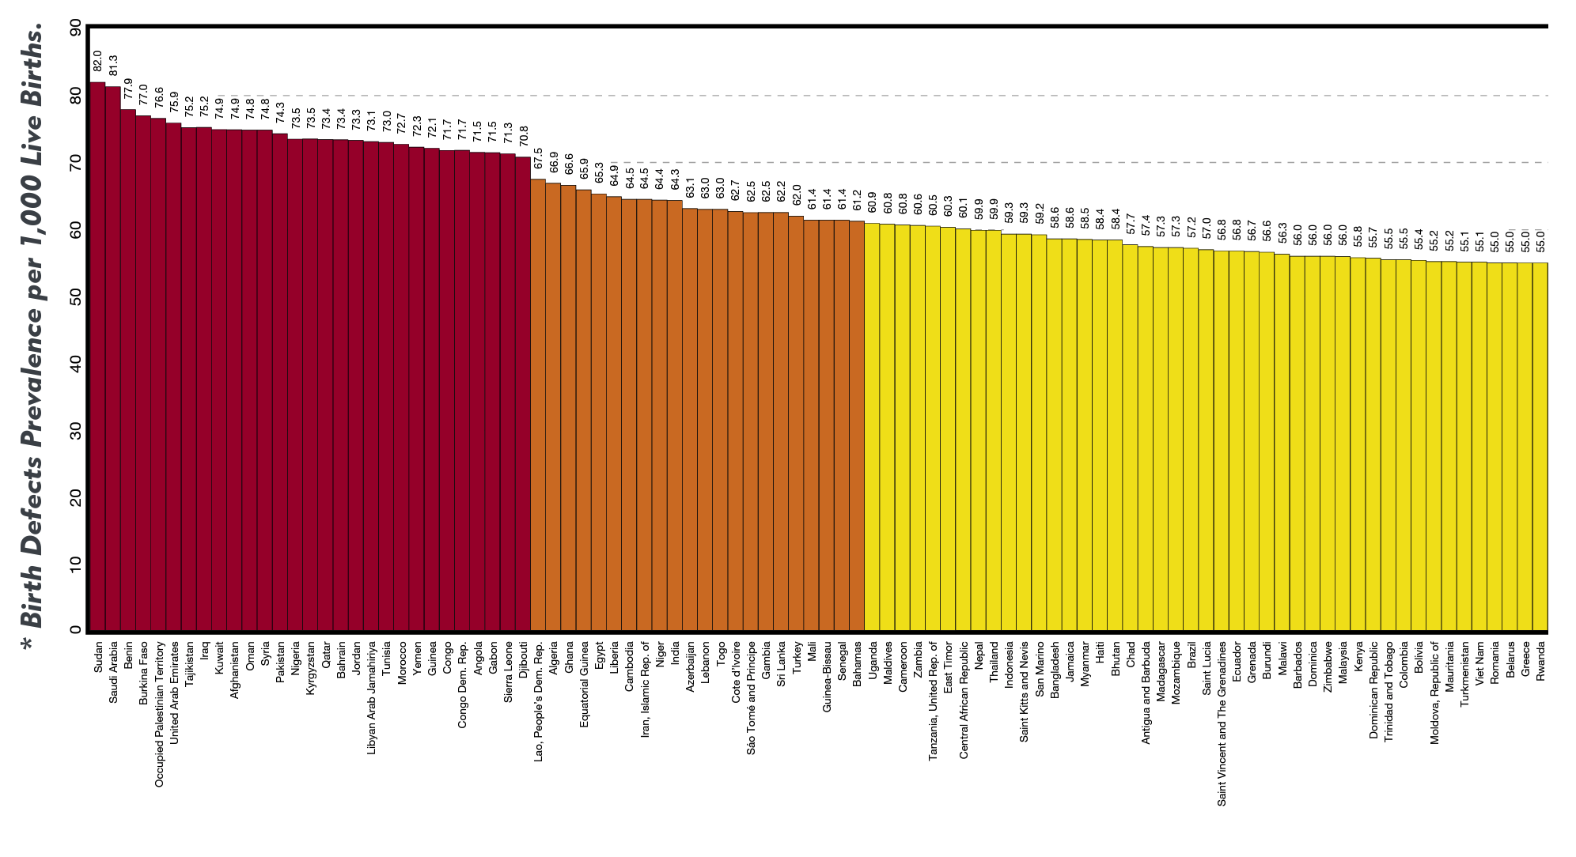
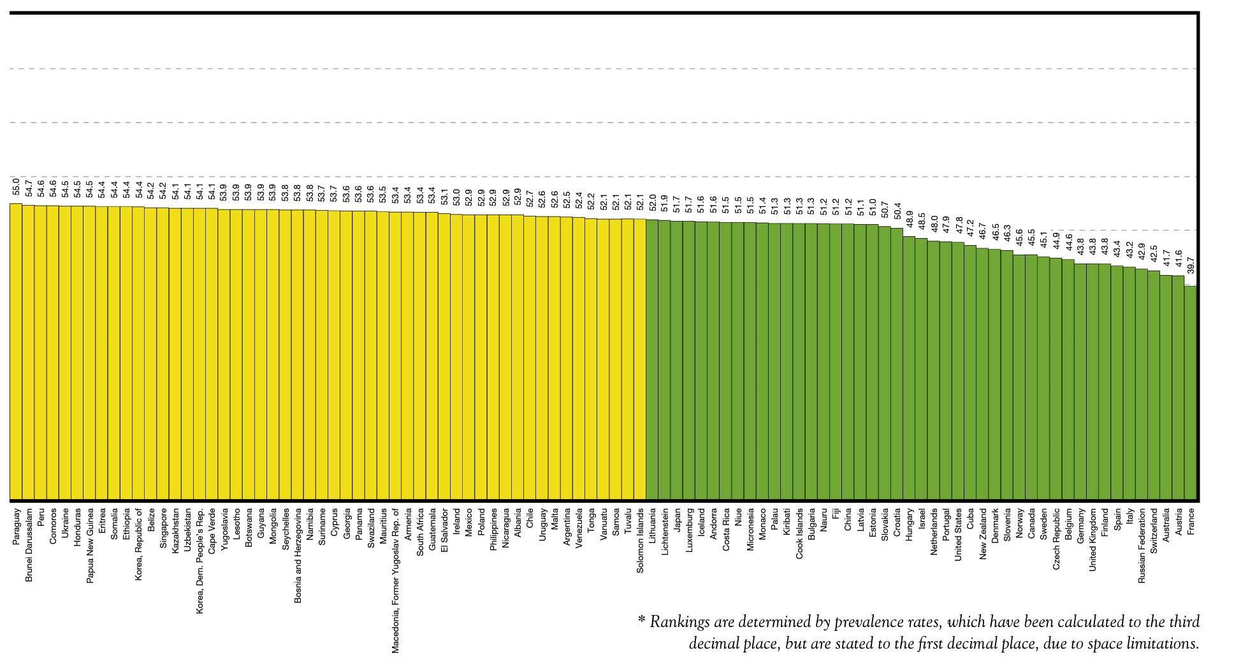
Nigeria estimated as 73.5 per 1000 live births
Highest birth prevalence of genetic birth defects among poorest countries, lowest rates among the wealthier countries, except for countries where common recessive disorders and where consanguineous marriages are common

Slide 6
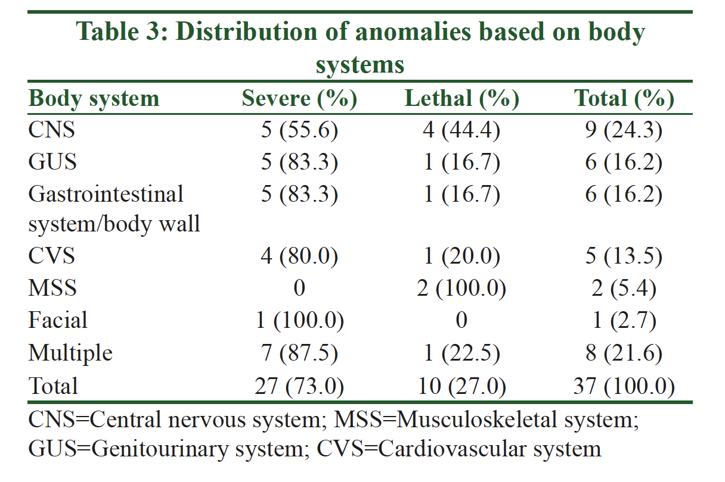
Congenital abnormalities SSA – Epidemiology 2
Akinmoladun et al. Pattern and outcome of prenatally diagnosed major congenital anomalies at a Nigerian Tertiary Hospital. Niger J Clin Pract 2018;21:560-5.
Variations in reported prevalence rates due to different study designs, settings and series
Abbey 2017; Akinmoladun 2018; Ekwochi 2018; Obu 2012
Ghana - 2.8% (28 per 1000) of newborn admissions – Anane-Fenin (2023) 27:837–849.
Notes:
Christianson, A., Howson, C. P., & Modell, B. (2006). March of dimes global report on birth defects: The hidden toll of dying and disabled children.
Anane Fenin 2023: This study was a retrospective descriptive research involving all neonates diagnosed with at least one congenital abnor-mality and admitted in the Special Care Infants Unit at the Cape Coast Teaching Hospital in the Central Region of Ghana between 1st January 2010 and 31st December 2019.
The 400-bed hospital serves as the primary tertiary refer-ral centre for Ghana’s Central and Western Regions but also receives referrals from sections of the Ashanti and Greater Accra regions due to proximity.

Slide 7
Causes and risk factors
Genetic - A minority of FCAs e.g. trisomy 21, single gene defects e.g. cystic fibrosis. Consanguinity increases the risk, ~doubles risk for neonatal/childhood death, intellectual disability.
Socioeconomic and demographic factors –
Low-income indirect determinant of congenital disorders
Higher frequency among resource-constrained families and countries.
~ 94% of severe FCAs occur in LMICs - lack of access to nutritious foods, health care and screening, increased exposure to infection, alcohol.
Advanced maternal age increases the risk of chromosomal abnormalities.
Environmental factors, maternal:
Infections (syphilis, rubella, Zika)
Exposure to radiation, certain pollutants
Nutritional deficiencies (e.g. iodine, folate deficiency)
Illness (diabetes) or drugs (alcohol, phenytoin).
Unknown - most

Slide 8
Background
HICs – structured prenatal counselling and screening, and the offer of termination of pregnancy for fetal anomalies have reduced birth prevalence and poor outcomes of FCAs
LMICs – most lack a structured system of prenatal screening and diagnosis for FCAs
Notes:
This study was a retrospective descriptive research involving all neonates diagnosed with at least one congenital abnor-mality and admitted in the Special Care Infants Unit at the Cape Coast Teaching Hospital in the Central Region of Ghana between 1st January 2010 and 31st December 2019.
The 400-bed hospital serves as the primary tertiary refer-ral centre for Ghana’s Central and Western Regions but also receives referrals from sections of the Ashanti and Greater Accra regions due to proximity.

Slide 9
Screening for FCAs
Screening
Preconception screening: - To identify those at risk of specific disorders or of passing a disorder onto their children. Obtaining family histories and carrier screening.
Peri-conception screening: -
Maternal characteristics screening - for young or advanced maternal age, alcohol, tobacco or other risks.
Ultrasound for Down syndrome and major structural abnormalities during the first trimester, severe fetal anomalies during the second trimester.
Maternal blood for placental markers of chromosomal abnormalities or neural tube defects, or for free fetal DNA to screen for many chromosomal abnormalities.
Diagnostic tests such as chorionic villus sampling and amniocentesis for chromosomal abnormalities and infections.
Newborn screening can reduce mortality/morbidity from congenital anomalies by facilitating earlier referral and initiation of medial/surgical treatment.
Early screening for hearing loss - opportunity for early correction, possibility of acquiring better language, speech and communication skills.
Early screening of newborns for congenital cataract also allows early referral and surgical correction which increases the likelihood of sight.
Screening for metabolic, hematologic and endocrine disorders, varying by country, depending on prevalence and cost.

Slide 10
Genetics
Prenatal screening for genetic anomalies
Combined First-Trimester Screening (CFTS)
Ultrasound and Fetal Imaging
Prematurity screening, prevention and management.
Genetic counselling, diagnosis and management (Fetal, Paediatric services)
understand the risks, benefits, and limitations of prenatal tests
Discuss results of tests already performed.
Follow-up post-natal genetics clinics to discuss inheritance and recurrence patterns

Slide 11
Treatment and care – medical and surgical
Varied access by country and health system, available in limited LMICs
Surgery and follow up care can mitigate lethality (e.g. congenital heart defects) or morbidity (e.g. congenital talipes, cleft lip/palate)
Contribution to reducing mortality and morbidity of treatment often underestimated.
Outcomes improved with early detection through screening, referral and management (at specialist centres)
Medical treatment for certain metabolic, endocrine and haematological conditions can improve QoL
e.g. congenital hypothyroidism - early detection and treatment allows full physical and mental development to healthy adulthood, whereas missed diagnosis or unavailability of treatment carries a risk of serious intellectual disability.
Children may require long term support - physical therapy, speech therapy, occupational therapy and support from families and community.

Slide 12
Multi-disciplinary team care
Obstetricians
Perinatologists
Geneticists
Endocrinologists
Radiologists
Cardiologists
Neonatologists – NICU facilities
Specialist midwives/nurses
Paediatric surgeons
Pathologists – perinatal

Slide 13
Fetal therapy
Drug therapy - steroids, antiarrhythmics
Percutaneous umbilical blood sampling (PUBS) for fetuses with severe anaemia
Fetal surgery
Fetal heart defects
Spina bifida
Laser treatment
Fetal transfusion
Shunt insertions – vesicoamniotic shunts
Congenital diaphragmatic hernias
Fetal tumours - sacrococcygeal teratomas

Slide 14
Pregnancy termination issues - Nigeria
Provision of safe pregnancy termination
For fetal abnormality
For maternal indications e.g. Breast cancer
What do the laws permit?

Slide 15
Notes:
Live births and proportion of maternal deaths due to abortion. Reprinted from The Lancet, Vol. 368, Grimes DA et al, “Unsafe abortion: the preventable pandemic,” pp. 1908–1919,

Slide 16
2019 Tropical Journal of Obstetrics and Gynaecology
Lack of a coordinated healthcare policy in relation to fetal medicine services.
Lack of standard policy recommendations regarding prenatal screening and diagnosis services –
Clarify and recommend minimum standards for prenatal aneuploidy screening, fetal imaging, and the provision of safe pregnancy termination services.
Need to outline number and content of “routine” US scans, with additional scan services being provided for high-risk pregnancies.
What options should women have dealing with lethal or very serious fetal abnormalities?

Slide 17
2019 Tropical Journal of Obstetrics and Gynaecology
Restrictive abortion laws, lack of abortion services limit potential clinical/economic benefits of US screening for fetal anomalies
~84% of developed countries permit abortion for fetal anomalies vs ~32% of countries in the developing region
Low level of health education and lack of adequate access to prenatal care including obstetric US
~30% of pregnant women in urban areas vs 6% in rural areas
Economic limitations on healthcare services: low gross domestic product and per capita expenditure on health
Nigeria’s per capita government health expenditure - $97 dollars in 2015 vs $9,536 dollars United States
Only 4.16% of total national budget allocated to health in 2017, less than for 2012.
Lack of health insurance access for >95% of the population
Notes:
Most antenatal facilities in rural areas are under equipped, without prenatal imaging facilities, making them of little or no benefit to pregnant women. Even in some urban areas where these facilities are available, most women undergo imaging studies for reasons other than screening for anomalies. In a study conducted in the southern part of Nigeria, investigating reasons why women desire prenatal US, fetal viability was foremost, closely followed by gender determination among other reasons. None of the women mentioned prenatal diagnosis of fetal anomalies; this is likely to be largely due to their ignorance of the services,[52,55] as well as to sociocultural beliefs which do not allow or empower women to make decisions regarding their pregnancies.

Slide 18
2019 Tropical Journal of Obstetrics and Gynaecology
Lack of appropriate infrastructure in the rural areas
Sociocultural and religious factors militating against fetal screening and diagnosis – affects accessing care and attitudes to TOP affected by a lethal anomaly
Poverty of training opportunities and skilled manpower
Use of poor-quality equipment/inadequate training on newly purchased equipment
Old/refurbished equipment
Poor maintenance, lack of culture

Slide 19
Recommendations for improvement
2019 Tropical Journal of Obstetrics and Gynaecology
National level
Low cost fetal imaging policy and services
Definition of a referral system and pathways – who does secondary scanning, tertiary scanning etc?
Regional referral networks for services at primary, secondary, and tertiary levels.
Multi-disciplinary team meetings across networks
Engenders culture of service evaluation and service audits
Can private facilities be enthused to join?
Simple, portable, and handheld US, minimizing costs for for servicing and maintenance

Slide 20
Program of training and certification
To ensure standards of practice meet the needs of the service users and communities
Collaborations between practitioners and agencies (ISUOG) in established institutions in high- and low- resource countries for:
Curriculum development
Skills transfer to inform improvements
Enhanced research and data acquisition
Funding required - by institutions requiring skilled manpower, institutions providing such training, or donor agencies
Definition of secondary and tertiary level expertise and services
Notes:
Apprenticeship model or proper modular certification
Diploma in Fetal Ultrasound
BSc or MSc in Obstetrics and Gynaecological ultrasound.

Slide 21
WHO global response
Resolution on birth defects of 63rd World Health Assembly (2010) - to promote primary prevention and improve the health of children with congenital disorders by:
developing and strengthening registration and surveillance systems;
developing expertise and building capacity for the prevention of congenital disorders and care of children affected;
raising awareness on the importance of newborn screening programmes to identify infants born with congenital disorders;
supporting families who have children with congenital disorders and associated disabilities; and
strengthening research on major birth defects, promoting international cooperation in combatting them.

Slide 22
WHO global response
Convenes annual training programmes on surveillance and prevention of congenital disorders. E.g. neural tube defects
Monitoring fortification of staple foods with folic acid
Improving laboratory capacity for assessing risks for folic acid-preventable congenital disorders
Assisting LMICs in improving control and elimination of rubella and congenital rubella syndrome through immunisation.
Develops normative tools, including guidelines and a global plan of action, to strengthen medical care and rehabilitation services to support the implementation of the United Nations convention on the rights of persons with disabilities.

Slide 23
Prevention – public health measures
Healthy diet, healthy weight for adolescent girls and mothers
Adequate dietary vitamins and minerals, particularly folic acid
Avoidance of harmful substances, particularly alcohol
Avoidance of travel to regions experiencing infections associated with congenital disorders
Reducing/eliminating environmental exposure to heavy metals or pesticides during pregnancy;
Controlling diabetes prior to and during pregnancy.
Careful health risk–benefit analysis before exposure of pregnant women to medications, radiation
Vaccination, especially against the rubella virus, for children and women;
Increasing/strengthening education of health staff, others involved in promoting prevention of congenital disorders; and
Screening for infections, especially rubella, varicella and syphilis, and consideration of treatment.

Slide 24
Educate the community, health professionals and workers, policy makers, the media, and other stakeholders about birth defects
Promote family planning, spacing pregnancies
Conduct physical examinations of all newborns by a trained physician, nurse or allied health professional before discharge

Slide 25
Conclusion
Multiple challenges to management of fetal congenital anomalies
Screening, Diagnosis, Management
Organisation of services - Local/Regional/National networks
Prevention, preconception and pregnancy health
Guidelines, Policy
Funding and Infrastructure
Education and Training
AFEMSON and SOGON can play major advocacy roles across policy and practice to raise awareness about FCAs, develop guidance and policy briefs, drive a training and education agenda to address the health systems issues and public health needs for mitigating the problems and challenges of FCAs

