Slide 1
Implementation Science Research in Fetomaternal Medicine: Bridging the Gap between Evidence and Practice
Professor Bosede B. Afolabi DM, FRCOG, FAMedS
Professor of Obstetrics & Gynaecology, College of Medicine, University of Lagos
Director, CCTRIS

Slide 2
Introduction
Sadly, Nigeria is now number 1 in maternal deaths globally
Almost 30%, approximating 82,000, with a maternal mortality ratio of 1,047 per 100,000 live births (1)
AFEMSON – specialists killed in promoting international standards in the practice of fetomaternal medicine in Nigeria and Africa
Goal of reducing maternal and perinatal mortality ratios in Nigeria

Slide 3
Different methods have been tried….
Proactively searching for means to actualize evidenced-based interventions (EBIs) in our routine practice
Move from traditional research to translational/ knowledge transfer/ dissemination research/ scaling up research (2)
To translate research findings on EBIs into routine practice
Otherwise called Implementation science

Slide 4
What is Implementation Science?
Implementation science (IS) is the systematic study of processes and factors designed to promote the adoption and integration of evidence-based practices, interventions, and policies into routine health care and public health settings (3)
It is associated with research that investigates the best ways to ensure that evidence-based information is integrated into practice

Slide 5
Why Implementation Science?
Close the gap between what we know works and what we do.
This is called the ‘know-do’ gap.
Increases the impact of evidence-based interventions (4,5)
Notes:
5.Lesley B. Olswanga, Patricia A. Prelockb. Bridging the Gap Between Research and Practice: Implementation Science. Journal of Speech, Language, and
Hearing Research. 2015: Vol. 58;S1818–S1826

Slide 6
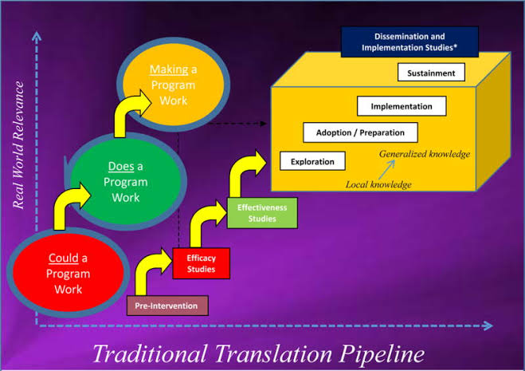
Research to practice gap
Traditional intervention research is not intentional about addressing the use of evidence
It takes 17 years to turn 14% of original research to the benefit of patient care (5)

Slide 7
Beyond the evidence for efficacy/effectiveness…
Evidence is only as good as how and whether…
It is adopted
Practitioners and communities are trained to use it
Trained practitioners and communities choose to use it
Eligible populations/patients benefit from it
If we assume a 50% threshold for each step…
Even with perfect access/adherence/dosage/maintenance
Impact: low benefit

Slide 8
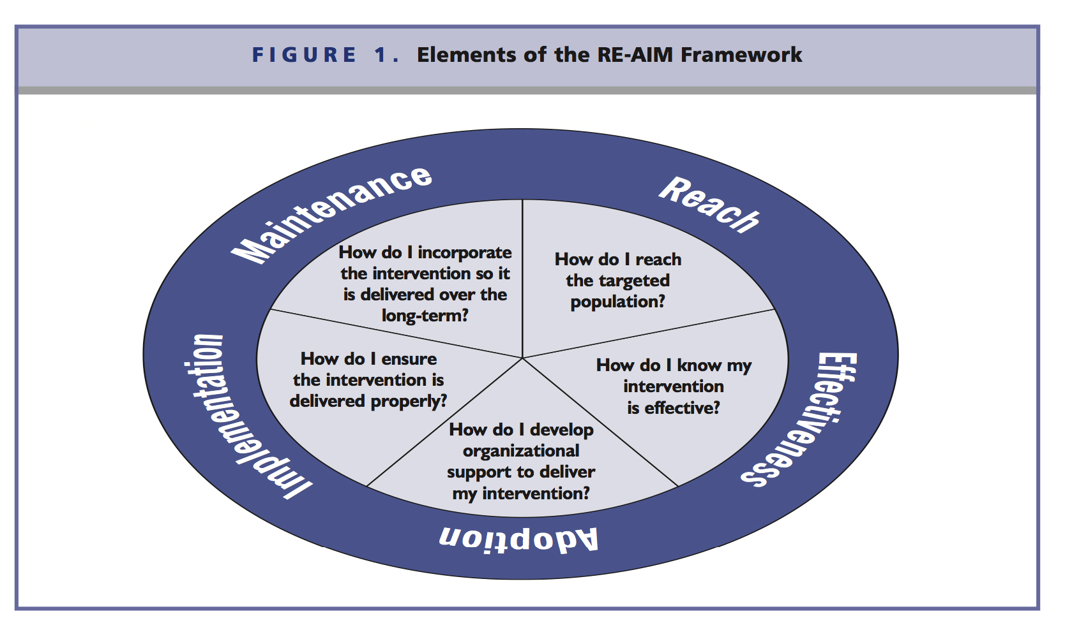
Beyond effectiveness….
Using RE-AIM Framework as an example (6)
Questions to ask…

Slide 9
Examples of evidence-based interventions yet to be fully integrated

Slide 10
1. Tranexamic acid
IV tranexamic acid (TXA) was found effective in treating and preventing PPH during vaginal and cesarean delivery
It reduced the rate of death significantly with no adverse effects
Unfortunately, the intervention is yet to be widely integrated

Slide 11
Post-trial impact of the study…
No study had explored the acceptability of tranexamic acid from HCPs perspectives
No known study on the implications for health governance and information systems.
Recommended IS research to establish a TXA-inclusive PPH treatment package to reduce death and disability related to PPH.

Slide 12
2. Intermittent preventive therapy
Identified barriers to the uptake of intermittent preventive therapy during pregnancy
Identified interventions that have been shown to improve IPTp coverage
Recommended eight strategies that will facilitate the uptake of IPTp
This can only be feasible with IS

Slide 13
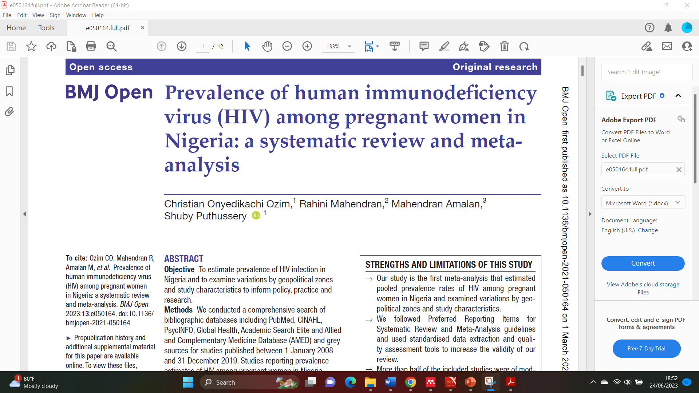
3. High prevalence of HIV among pregnant women
Prevalence is still high
A need for an in-depth understanding of associated sociocultural and environmental factors
Qualitative studies can facilitate richer responses
Enhance the development of policies and practical guidelines to reduce this high prevalence
This can be achieved through IS research

Slide 14
So, what next?
Engage more in translational research to fill the gap between theory to practice
Conduct an implementation science study on EBIs to increase their impact
Increase the uptake/adoption/ sustenance of these EBIs
Aim of reducing the high maternal mortality rate in Nigeria

Slide 15
Examples of IS research ongoing…

Slide 16
Case study 1
A hybrid type 1 effectiveness-implementation research
Aimed to facilitate the speed up of the translation of research into practice.
Conducted in Lagos and Kano states, Nigeria, between August 2021 to June 2023
Among 1056 pregnant women with iron deficiency anaemia (IDA)
Intervention: Intravenous iron to treat moderate to severe IDA in pregnancy

Slide 17
 | Implementation Outcome | Data Collection Timepoint(s) |  |  | Target Stakeholders | Mode of Data Collection
 |  | Baseline (Formative Assessments) | During | End of Study
1 | Acceptability (includes facilitators and barriers) | X |  | X | Healthcare workers, pregnant women and their partners, health facility managers, state government health officials, policymakers | AIM survey and site assessment tool, FGDs, KIIs
2 | Feasibility | X | X | X | Healthcare workers | FIM survey tool, FGDs
3 | Fidelity |  | X |  | Healthcare workers (only those delivering intervention) | Intervention procedure checklist and in-depth interview
4 | Cost-effectiveness |  | X | X | Pregnant women, healthcare workers, hospital administrators | Cost survey and logbook
Hybrid Type 1 Effectiveness-Implementation Design
Intervention: IV Ferric carboxymaltose
Control: Oral Ferrous sulphate
Primary aim: Effectiveness
Secondary aim: Implementation
Clinical outcomes
(Measure impact of intervention)
Implementation outcomes
(Measure context (barrier/facilitators) relating to implementation of intervention)
Study participants
Pregnant women
Infants
Stakeholders
Healthcare workers
Pregnant women and their partners
Health facility managers
State government health officials and policymakers
Primary outcomes
%Maternal anaemia at 36 weeks
Preterm delivery
Secondary outcomes
Safety and tolerability of maternal study medications
Other severe maternal events e.g., shock, haemorrhage
Infant outcomes e.g., birthweight, mortality
Maternal depression
Acceptability: the state of meeting stakeholders needs, preferences, and expectations
Feasibility: degree of intervention being easily done.
Fidelity: degree to which intervention is delivered as intended
Cost-effectiveness

Slide 18
Findings on Acceptability
Conclusion
IV iron has a high potential to be a preferred method to treat AIP in Nigeria.
To be widely accepted, the following should be considered:
-HCP training
-Optimisation of antenatal care
delivery
-Tailoring existing health talk to
include IV iron
-Uninterrupted supply
-Subsidies to offset the presumed
high-cost

Slide 19
Case study 2
This is purely an IS research
Complement the IVON trials by using continuous quality improvement to evolve and test strategies to strengthen existing diagnostic processes for IDA in pregnancy and post-partum
Test strategies to strengthen referral and facilitate the routine treatment of moderate to severe IDA with IV iron within Nigeria’s health system

Slide 20
Usefulness of IS in Fetomaternal research
Allow the identification of barriers affecting the uptake of EBIs and enhance facilitators
Enable the researcher to proactively address the barriers and act on the facilitators
Narrow or eliminate the know-do gap and promotes equitable access and use of EBIs for all eligible populations in resourced limited settings like ours
Facilitates the linkage of evidence to practice and policy so that the benefits of new findings are not delayed but sustainable.

Slide 21
Conclusion
Evaluating the EBIs through implementation science research will facilitate the uptake of that intervention
Enhance wide coverage
Yield holistic evidence critical for guiding the future implementation
Enhance dissemination procedures and scale-up/ sustainment of the EBIs strategically at the multisystemic level

Slide 22
Acknowledgement
Thank you for your audience!
Dr Opeyemi Akinajo for assistance with the slides

Slide 23
Reference
1. WHO, UNICEF, UNFPA, World Bank Group, and the United Nations Population Division. Trends in Maternal Mortality: 2000 to 2017.
2. Olswang LB, Prelock PA. Bridging the Gap Between Research and Practice: Implementation Science. J Speech Lang Hear Res. 2015 Dec;58(6):S1818-26. doi: 10.1044/2015_JSLHR-L-14- 0305. PMID: 26262822.
3. Ashrafzadeh S, Metlay JP, Choudhry NK, Emmons KM, Asgari MM. Using Implementation Science to Optimize the Uptake of Evidence-Based Medicine into Dermatology Practice. Vol. 140, Journal of Investigative Dermatology. Elsevier B.V.; 2020. p. 952–8.
4. Lawrence W Green. Making research relevant: if it is an evidence-based practice, where’s the practice-based evidence? Fam Pract.2008;25 Suppl 1:20-4.
5. E A Balas, S A Boren. Managing Clinical Knowledge for Health Care Improvement. Yearb Med Inform. 2000;(1):65- 70
6. Glasgow Russell E., Harden Samantha M., Gaglio Bridget, Rabin Borsika, Smith Matthew Lee, Porter Gwenndolyn C., Ory Marcia G., Estabrooks Paul A.RE-AIM Planning and Evaluation Framework: Adapting to New Science and Practice With a 20 Year Review. Frontiers in Public Health 2019:7

