Slide 1
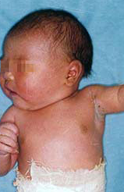
ATTITUDE AND PRACTICE OF MEDICAL PROFESSIONALS TOWARDS PRENATAL ULTRASOUND SCREENING FOR CONGENITAL ANOMALIES
Authors: J.A Akinmoladun. E Enabudoso. R.B Olatunji:
PRESENTER: Alero ogbebor.
REPRODUCTIVE HEALTH, Department OF OBSTETRICS AND GYNAECOLOGY, center of excellence in reproductive health innovation, UNIVERSITY OF BENIN.

Slide 2
OUTLINE
INTRODUCTION
METHODOLOGY
RESULTS
FINDINGS
CONCLUSION

Slide 3
Introduction
For several decades, ultrasound imaging has been the preferred method of imaging fetal anomalies in the developed world, due to its cost-effectiveness, easy accessibility, safety for mother and fetus and real time imaging.
As prenatal diagnosis gains traction in our environment, it is imperative to assess the attitude of doctors towards the practice, as it is crucial for its widespread adoption in order to improve quality of care and aid design of relevant programs for necessary intervention.
This study therefore sought to assess the attitude of medical professionals to prenatal ultrasound screening for congenital anomalies.
Afemson 6th general meeting

Slide 4
methodology
This study was a cross-sectional descriptive study conducted during a practical obstetric ultrasound training course organized by the Fetal Medicine Unit of the University of Benin Teaching Hospital, Benin City Nigeria.
This study was conducted with the aid of a self-administered semi–structured questionnaire. The questionnaire sought information on bio data, clinical practice level, scope of sonographic practice of the respondents, attitude and current practice of the respondents as it pertains to fetal anomaly ultrasound scan as well as termination of pregnancies following ultrasound diagnosis of different severities of fetal anomalies.
77 participants whom were attendees of the training course participated in the study.
Afemson 6th general meeting

Slide 5
results
Bio Data
The study sample comprised of 58 males (75.3%) and 19 females (24.7%)
the age of participants were between 20- 60 years. With a bulk of the population (41.6%) between 40-50 years.
81.8% worked in tertiary hospitals while others worked in general hospitals.
71% were consultant obstetricians while 21% were resident doctors.
Afemson 6th general meeting

Slide 6
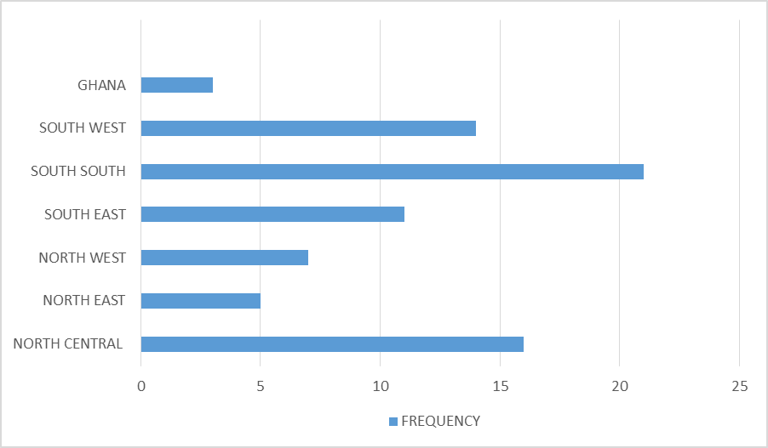
COMPOSITION OF PARTICIPANTS BY GEOGRAPHICAL ZONES
All geographical zones of the country were represented with a majority from the South-South and North-Central Nigeria, and a hand full from Ghana.

Slide 7
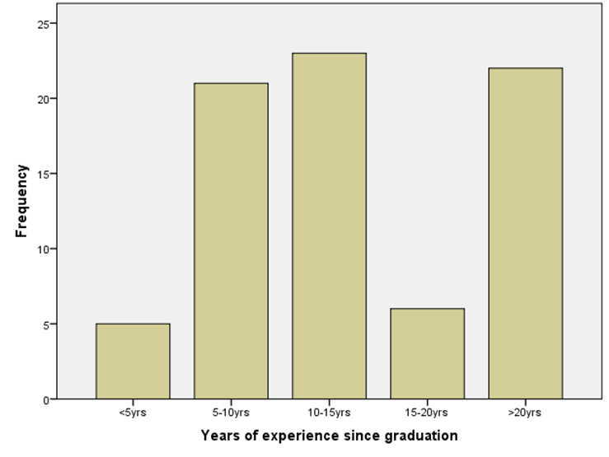
DISTRIBUTION OF THE YEARS OF EXPERIENCE OF THE PARTICIPANTS
About half of the respondents were between 5 – 15 years post graduation.

Slide 8
ATTITUDE
88% of respondents feel that fetal anomaly scan should be done between 18 - 22 weeks gestational age while one in 10 respondents feel it should be done earlier.
88% of respondents did not consider experience in 3D and 4D ultrasound scans to be a sure proof of high proficiency in fetal anomaly scan.
All respondents believe that fetal anomaly scan is inadequate to rule out congenital malformations in all cases even in the best hands.
Question n(%)
At what GA do you believe fetal anomaly scan is best done? <18wk8(10.4) 18-22wk68(88.3) >22wk1(1.3) Is expertise in 3D or 4D ultrasound a sure proof of competence in FAS? Yes 9(11.7) No 68(88.3) Does fetal anomaly scan rule outpresence of all fetal anomalies? Yes 0(0) No 77(100)

Slide 9
ATTITUDE
Question n(%)
Are fetal anomalies common in Nigeria? Yes 58(75.3) No 19(24.7) TOP for lethal anomalies? Yes 61(79.2) No 16(20.8) TOP for anomalies that may reduce quality of life? Yes 21(27.3) No 56(72.2) TOP for confirmed Down syndrome? Yes 27(35.1) No 50(64.9) Knowledge about abortion law? Yes 73(94.8) No 4(5.2)
79.2% will advocate for pregnancy termination for lethal fetal anomalies.
27.3% will advocate for termination of anomalies which may reduce the quality of life of the baby.
The advocacy for abortion depends on the severity of the anomaly detected, gestational age at diagnosis and patient’s interest.
Majority of the respondents were aware of abortion laws in the country.

Slide 10
practice
E
Question n(%)
Is patient referral for FAS routine for all pregnancies Yes 10(13) No 67(87) What type of informed consent do you routinely obtain for FAS? Written 3(3.9) Verbal 32(41.6) None 42(54.5) Is there established protocol for communicating result of FAS? Yes 12(15.6) No 65(84.4) Is there established protocol for managing pregnancies with fetal anomalies? Yes 8(10.4) No 69(89.6) Is there expertise for therapeutic prenatal intervention? Yes 8(10.4) No 69(89.6)
Only 13% of respondents refer patients for routine fetal anomaly scans while more than two- thirds (70.1%) reserve referral for fetal anomaly scans to only cases at high risk of congenital malformations.
Only 46% obtain informed consent for fetal anomaly scan with a high proportion of this bulk (90%) obtaining consent verbally.
65% of respondents practice where there is a lack of established protocol for communicating results of fetal anomaly scan to the patient and referring physician.

Slide 11
FINDINGS
Fetal anomaly scan is observer dependent and may not be able to detect all possible fetal structural anomalies.
Fetal anomaly scan is not yet routinely done in Nigeria.
Low referral rate for routine prenatal sonographic screening service which may be attributed to level of availability of such service to the population.
Lack of access to advanced obstetric ultrasound service may be a major cause for the increasing perinatal manifestations of congenital anomalies in Nigeria.
Lack of established protocol guiding the conduct and management of fetal anomaly scans as observed among respondents.
There is a need for improvement in the informed consent process.

Slide 12
CONCLUSION
The findings of this study highlight the need for improvement of training in fetal medicine and prenatal diagnosis.
It also reiterates the need for the review of abortion laws in Nigeria especially on the issues of lethal fetal anomalies.
It calls for a need for established protocols to guide the practice, diagnosis, decision and management of these congenital anomalies found in pregnancy so as to improve the quality of care.
Afemson 6th general meeting

Slide 13
REFERENCES
World Health Statistics 2008. World Health Organization, Geneva 2008. EB 125/7.
Workshop on Fetal Medicine and Obstetric Ultrasound. www.beninfetaldiagnostics.org/workshop.
World Health Organization 2016. Media fact sheet on congenital anomalies. www.who.int/mediacentre/factsheets/fs370/en/. Accessed on 02/12/2017.
Ingeborg B. Epidemiological surveillance of congenital anomalies in Europe. ZDRAV VESTN 2009; 78: 175-179
Enabudoso E and Ikubor J. The challenges of diagnosis nad management of fetal anomalies in low resource settings. African Journal of Tropical Medicine and Biomedical Research. 2013; 2:7-12
Afemson 6th general meeting

Slide 14
Thank You
alero.ogbebor96@gmail.com

