Slide 1
Bharat Serums And Vaccines Limited
bringing life to life

Slide 2
Values We Stand By
To be an innovative, caring and trustworthy partner in bringing life to life
Mitigating the anguish and suffering of millions.
Underlying fairness and transparency in dealings with all stakeholders including employees and business partners.
The Group is driven by an informal culture fostering cohesion and innovation.

Slide 3
BSV’s Research and Development Infrastructure
India R&D Center
The Indian R&D unit houses the following facilities:
Biotech Process Development Center Unit
Biological Product and Process Development Unit
NDDS Product and Process Development Unit
Analytical Development Unit
Preclinical ( small animals)
German Subsidiary, BSV Biosciences GmBH.
Focuses on developing protein based therapeutic products derived from natural sources.
Initial product development and process development activity is undertaken in the German subsidiary.
US Subsidiary, BSV Biosciences Inc.**
Focuses on developing recombinant proteins and monoclonal antibodies
Initial molecular biology and genetic engineering activities leading to development of cell lines are carried out in the US subsidiary.
**Operations have been scaled down since 2010 as the focus in now on commercializing the products

Slide 4
Rh disease and need for local guidelines
Rh-
Rh+

Slide 5
Rh disease and need for local guidelines

Slide 6
Background: Nigeria
Allagoa DO, Oriji PC, Briggs DC, Ikoro C, Unachukwu CE, Ubom AE, Atemie G, and Eneni B. (2021). Rhesus negative pregnancy: prevalence and foetomaternal outcomes in a tertiary hospital, South-South Nigeria. Eur. J. Med. Health Sci., 3(5), 123-131.
Jeremiah ZA, Mordi A, Buseri FI, Adias TC. Frequencies of maternal red blood cell alloantibodies in Port Harcourt, Nigeria. Asian J Transfus Sci. 2011 Jan;5(1):39-41. doi: 10.4103/0973-6247.75987
IPPF Africa, Planned Parenthood, https://africa.ippf.org/media-center/ippf-launches-free-online-medical-abortion-course retrieved on 24/05/2023

Slide 7
Background: Nigeria
Reported Rh⁻ prevalence between 2.27%¹ and 8.6%²
10,500,000 pregnancies annually, 2,990,000 unintended, 1,430,000 ended in abortion.3
Eligible population 162K. Only ~43K (~27%) annually receive Anti-D prophylaxis
No National guidelines and very low usage of antiD prophylaxis especially in resource limited settings
Lack of information on how many women get their blood grouping done during pregnancy
Access to ICT is limited
Severe lack of awareness about HDFN, Blood grouping, and prophylaxis among women
Allagoa DO, Oriji PC, Briggs DC, Ikoro C, Unachukwu CE, Ubom AE, Atemie G, and Eneni B. (2021). Rhesus negative pregnancy: prevalence and foetomaternal outcomes in a tertiary hospital, South-South Nigeria. Eur. J. Med. Health Sci., 3(5), 123-131.
Jeremiah ZA, Mordi A, Buseri FI, Adias TC. Frequencies of maternal red blood cell alloantibodies in Port Harcourt, Nigeria. Asian J Transfus Sci. 2011 Jan;5(1):39-41. doi: 10.4103/0973-6247.75987
IPPF Africa, Planned Parenthood, https://africa.ippf.org/media-center/ippf-launches-free-online-medical-abortion-course retrieved on 24/05/2023
Notes:
Allagoa DO, Oriji PC, Briggs DC, Ikoro C, Unachukwu CE, Ubom AE, Atemie G, and Eneni B. (2021). Rhesus negative pregnancy: prevalence and foetomaternal outcomes in a tertiary hospital, South-South Nigeria. Eur. J. Med. Health Sci., 3(5), 123-131.
Jeremiah ZA, Mordi A, Buseri FI, Adias TC. Frequencies of maternal red blood cell alloantibodies in Port Harcourt, Nigeria. Asian J Transfus Sci. 2011 Jan;5(1):39-41. doi: 10.4103/0973-6247.75987
IPPF Africa, Planned Parenthood, https://africa.ippf.org/media-center/ippf-launches-free-online-medical-abortion-course retrieved on 24/05/2023

Slide 8
Possible reasons for continuing cases of Rh isoimmunization
Cost of procuring anti-D
Absence of a universal access program for all Rh-negative women;
Failure to recognize potential sensitizing events in pregnancy as such and to treat them appropriately
Poor and sometimes the absence of alloimmunization prevention during illegal termination of pregnancy in Rh-negative women;
A dearth of information about previous pregnancies and termination in patients’ medical files due to poor data management;
Failure to comply with postpartum prophylaxis guidelines to offer further anti-D immunoglobulin to all Rh-negative women delivered of Rh-positive babies within 72 hours of delivery depending on the extent of FMH;
failure to offer Rh-negative pregnant women anti-D immunoglobulin following any potentially sensitizing event during pregnancy
Osaro E, Charles AT. Rh isoimmunization in Sub-Saharan Africa indicates need for universal access to anti-RhD immunoglobulin and effective management of D-negative pregnancies. Int J Womens Health. 2010 Dec 1;2:429-37. doi: 10.2147/IJWH.S15165. PMID: 21270966; PMCID: PMC3024894.

Slide 9
: Pegoraro V, Urbinati D, Visser GHA, Di
Renzo GC, Zipursky A, Stotler BA, et al. (2020)
Hemolytic disease of the fetus and newborn due to
Rh(D) incompatibility: A preventable disease that
still produces significant morbidity and mortality in
children. PLoS ONE 15(7): e0235807. https://doi.
org/10.1371/journal.pone.0235807

Slide 11
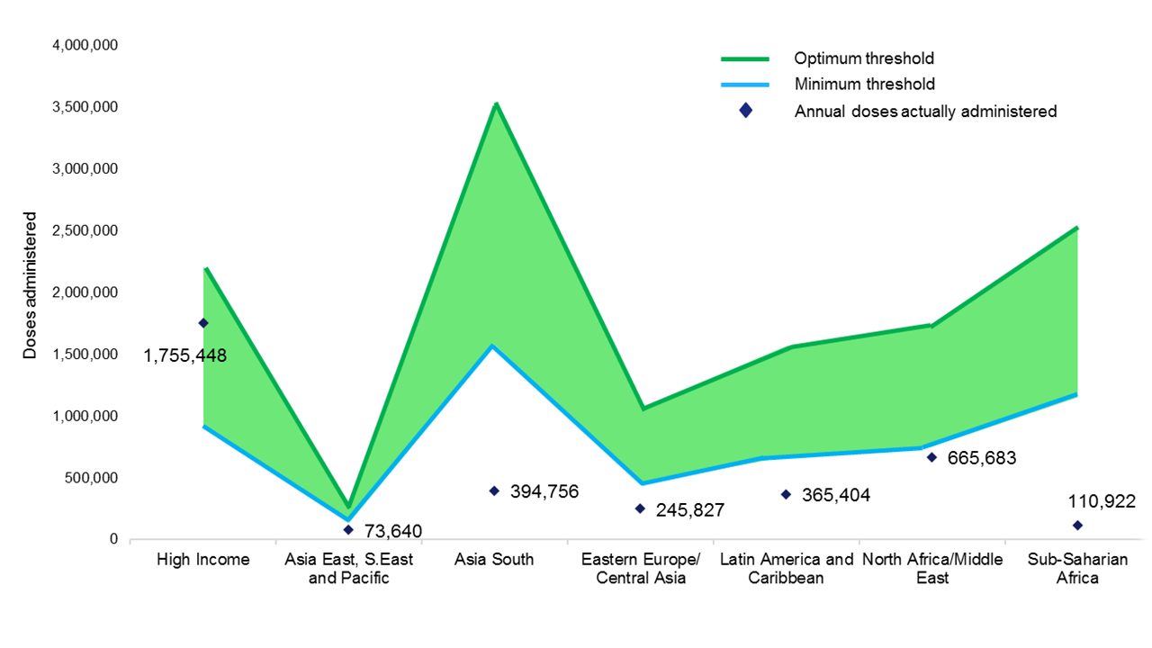
Hemolytic disease of the fetus and newborn due to Rh(D) incompatibility: A preventable disease that still produces significant morbidity and mortality in neonates & children
IgG anti-Rh(D) doses actually administered annually, as compared with minimum and optimum thresholds for immuno-prophylaxis.
Sub-Saharan Africa, Latin America & North Caribbean, South Asia, South East Asia, Eastern Europe / Central Asia has significantly under administered Anti-D prophylaxis

Slide 12
Bhutani, V., Zipursky, A., Blencowe, H. et al. Pediatr Res 74 (Suppl 1), 86–100 (2013)

Slide 13
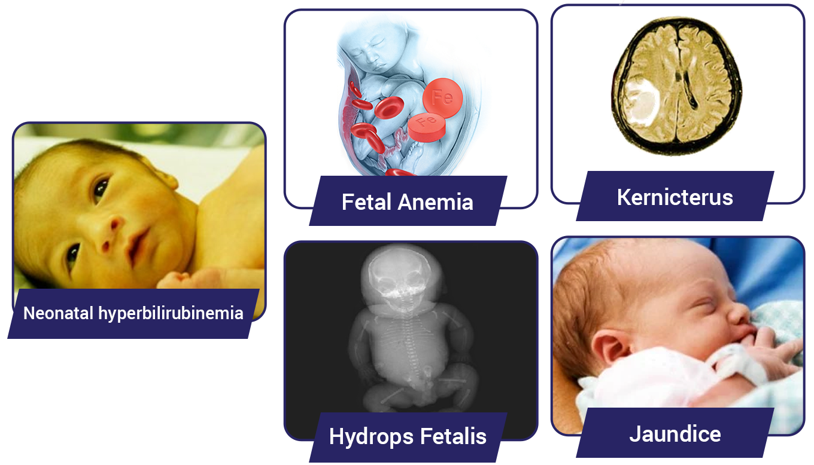
Rh Incompatibility Complications
Antenatal
Erythroblastosis Fetalis
Fetal Anemia
Hydrops Fetalis
Kernicterus
Hyperbilirubinemia and Jaundice
Perinatal
Erythroblastosis Neonatorum
Hydrops Fetalis
Neonatal hyperbilirubinemia and Jaundice

Slide 14
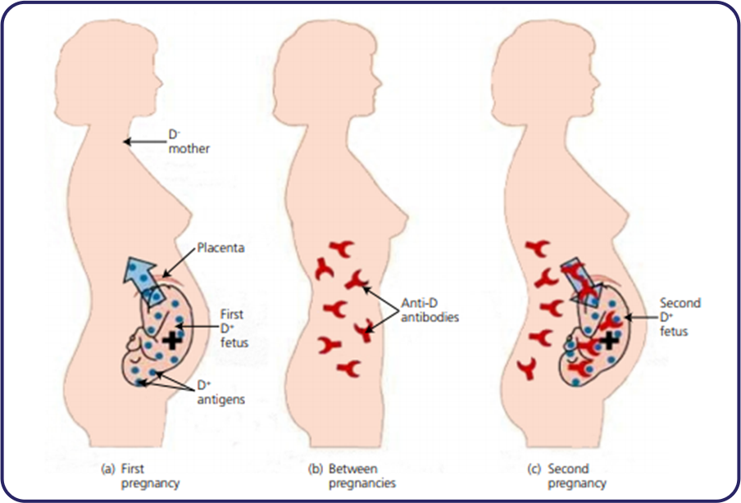
Anti-D Prophylaxis
Anti-D immunoglobin (Ig) is given to a woman to prevent her producing antibodies against RhD positive blood cells, thus preventing development of HDN in an unborn baby.
Extracted from the plasma of donors having high circulating levels of anti-D.
Given usually intramuscularly or sometimes intravenously; prevents sensitization during pregnancy and after childbirth
Development of anti-D antibodies usually occurs as a result of FMH in a RhD-negative woman with an RhD- positive fetus.
Should be administered
As soon as possible after the potentially sensitizing event but always within 72 h.
Within 10 days may provide some protection.
Intramuscularly anti-D is best given in deltoid muscle.
Women already sensitized should not be given anti-D Ig.
Haemolytic disease of the fetus and newborn

Slide 15
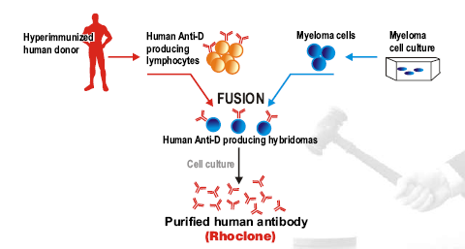
Monoclonal Anti – D immunoglobulin - Rhoclone
Highly specific antibodies against single antigenic epitope produced by the clone of a single hybrid cell formed in the laboratory by the fusion
Advantages
Specific
Consistent
Uniform
Safe from transmission of viruses and harmful proteins

Slide 16
Comparison
Features | Polyclonal | Monoclonal
Efficacy | Lower & inconsistent | Greater & Consistent
Specificity | Mixed | High
Purity | Contains other antibodies and plasma proteins | Highly purified
Lot to Lot variation | Present | Nil
Risk of transmission of viral diseases | some | No
Supply | Possibility of shortages due to unavailability of healthy donors | Unlimited supply

Slide 17
Indication and dosage
Anti Rho-D immunoglobulin is indicated to prevent Rho-D negative women from forming antibodies to foetal rhesus - positive red blood cells, that may pass into the maternal blood during child birth, abortion or certain other sensitising events.
Dosage:
A dose of 300 mcg should be given intramuscularly as soon as possible during first 3 days after delivery.
In cases of abortion or termination of pregnancy, the Rh negative women should be given 150 mcg of Rhoclone within 72 hours, if the pregnancy is of 12 weeks duration or less.
In cases of miscarriage in an advanced stage of pregnancy, 300 mcg should be administered.

Slide 20
Need for guidelines on Rh disease prevention in Nigeria
Best practices: Nigeria and other African countries need to implement best practices to optimize the care offered to Rh negative pregnant women.
Immunization coverage: Despite improving healthcare, Nigeria has witnessed gradual but consistent reduction in immunization coverage, which is among the lowest in the world.
Rejection of vaccines: Many decision-makers and caregivers reject routine immunization due to rumor, incorrect information, and fear.
Health worker-related factors: Health worker-related factors can hinder the delivery of vaccination communication interventions.
https://www.intechopen.com/chapters/70657
https://apps.who.int/iris/bitstream/10665/250796/1/9789241549912-eng.pdf
https://www.ncbi.nlm.nih.gov/pmc/articles/PMC4139536/

Slide 21
Focus of Guidelines for robust Rh immunization in Nigeria
Prevention of RhD alloimmunization in Rh-negative pregnant women through the administration of RhD immunoglobulin at 28-34 weeks of gestation and within 72 hours after delivery.
WHO recommendations for routine immunization, including both antenatal and postnatal doses for unsensitised Rh-negative mothers.
Strategies to improve immunization coverage, including awareness of people's attitudes and the influence of these on immunization, use of reminder/recall services, and addressing delayed or missed vaccinations.
For Rh negative women, administering other pregnancy related vaccination during the same visit as Rho(D) immune globulin administration is a strategy worth considering.
https://apps.who.int/iris/bitstream/10665/250796/1/9789241549912-eng.pdf
https://www.who.int/news-room/fact-sheets/detail/immunization-coverage
https://bmcpublichealth.biomedcentral.com/articles/10.1186/s12889-017-4020-6

Slide 22
Thank you !

