Slide 1

WOMAN 2: Post Partum Haemorrhage and Anaemia
Oladapo Olayemi
Professor of Obstetrics and Gynaecology
University of Ibadan
National Coordinator WOMAN 2 Trial

Slide 2
PURPOSE OF THIS PRESENTATION
Overall goal is to make implementation of the results easier at the end of the trial if it provides evidence for the benefit of TXA in PREVENTING PPH
Outline:
Building on Evidence from the WOMAN Trial
The WOMAN 2 trial journey so far
Lessons learnt from WOMAN 2
What next?

Slide 3
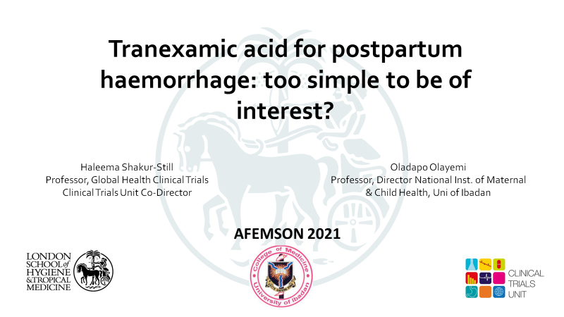
Introduction
WOMAN Trial results and need for implementation presented at the last AFEMSON conference
WOMAN 2 is based on some critical findings in the WOMAN trial
The aim of this presentation is to familiarise us with this trial to improve implementation of findings later

Slide 4
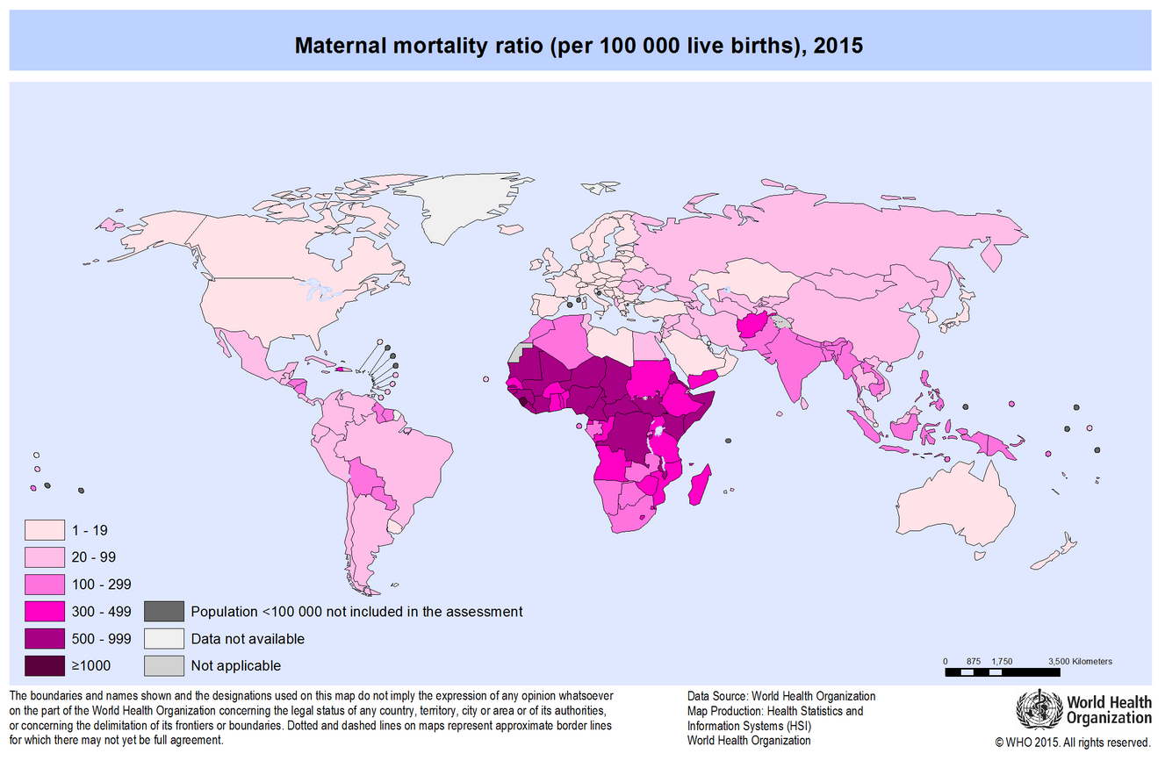
PROBLEM STATEMENT: MATERNAL MORTALITY
Approximately 300,000 women die every year due to complications in pregnancy and childbirth
99% of deaths occur in low- and middle-income countries
Maternal mortality ratio (per 100,000 live births), 2015
Say L et al. BMC Reproductive Health 2004;1(3).
WHO, UNICEF, UNFPA and The World Bank estimates. 2015

Slide 5
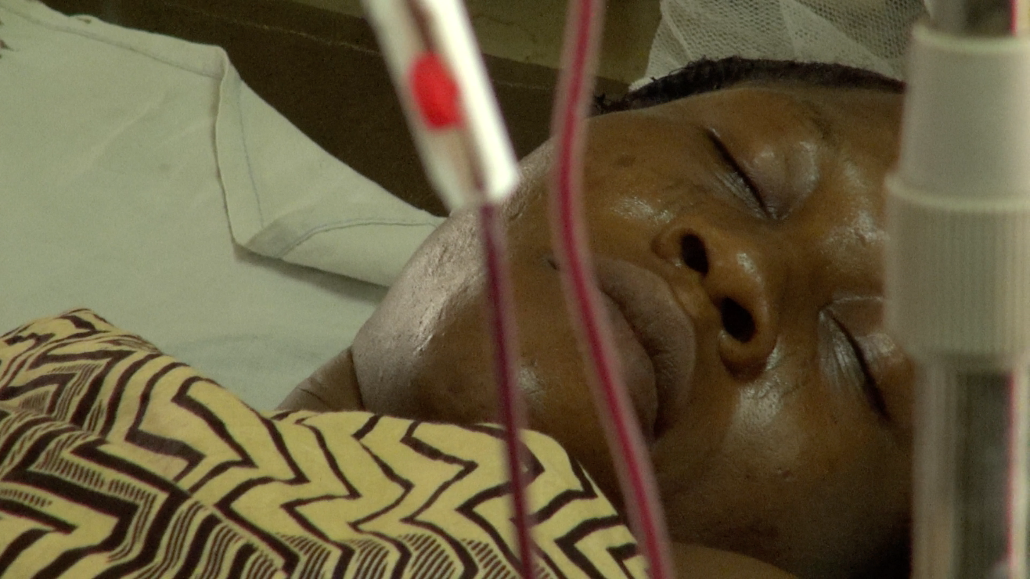
MATERNAL MORBIDITY
Many women who survive PPH suffer severe morbidity:
Surgical intervention (e.g. uterine artery ligation, brace sutures)
Hysterectomy
Lead to or worsen existing anaemia
Morbidity can interfere with breastfeeding and bonding
Blood transfusion

Slide 6
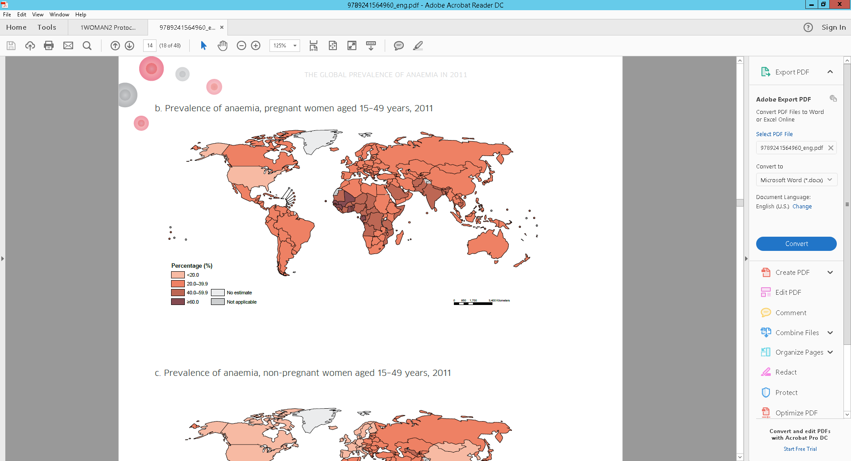
MATERNAL ANAEMIA AND PPH
Women with anaemia are more likely to have a PPH and to suffer worse outcomes
Worldwide, over one third of pregnant women are anaemic
Prevalence of anaemia, pregnant women aged 15–49 years, 2011
Prevalence is highest in countries in Central and West Africa as well as in South Asia where about half of pregnant woman are anaemic
Nair et al. BMJ Global Health. 2016;1(e000026).
Sheldon et al. BJOG 2014;121, 1:5-13.
WHO. The global prevalence of anaemia in 2011. Geneva: WHO; 2015.

Slide 7
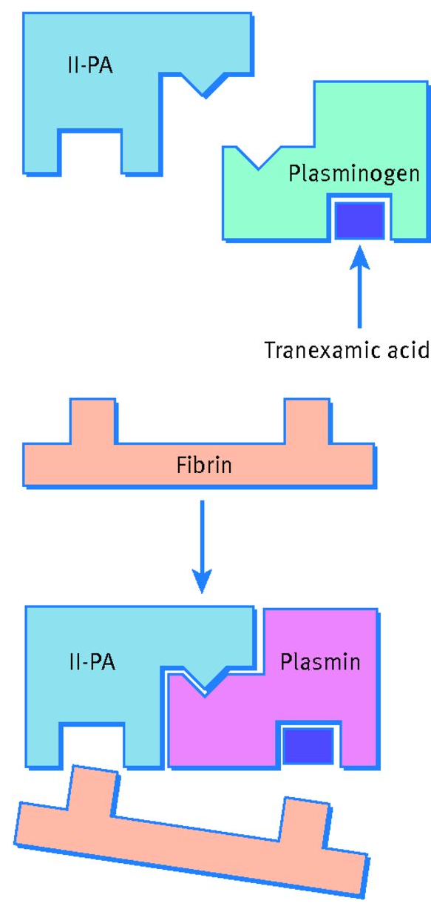
TRANEXAMIC ACID (TXA)
TXA is a synthetic analogue of the amino acid lysine
TXA exerts an antifibrinolytic effect by forming a reversible bond with the lysine binding site on the plasminogen molecule
Plasmin is therefore prevented from interacting with fibrin and clot stability is achieved
TXA is marketed in tablet and injection form as a treatment for a variety of chronic and acute bleeding conditions
Mahmood et al. BMJ 2016;354:bmj.i4814

Slide 8

TXA FOR TREATING PPH
20,060 women with PPH after a vaginal birth or caesarean section were recruited from 193 hospitals in 21 countries
Patients were randomised to receive either 1 g TXA or matching placebo in addition to usual care. If bleeding continued after 30 min, or stopped and restarted within 24 hr of the first dose, a second dose of 1 g of TXA or placebo could be given
The WOMAN trial Collaborators. Lancet. 2017 ; 389 (10084): 2105-16.

Slide 9
WOMAN TRIAL RESULTS
Early treatment (≤3 hrs)
RR (95% CI)
PPH 0.69 (0.53–0.90)
Late treatment (>3 hrs)
PPH 1.07 (0.76–1.51)
.5
.6
.7
.8
.9
1
1.1
1.2
1.3
1.4
1.5
1.6
TXA better
TXA worse
TXA is most effective when given within three hours of birth
TXA reduces death due to bleeding by one third
No increase in adverse effects, including thromboembolic events

Slide 10
WOMAN TRIAL RESULTS

Slide 11
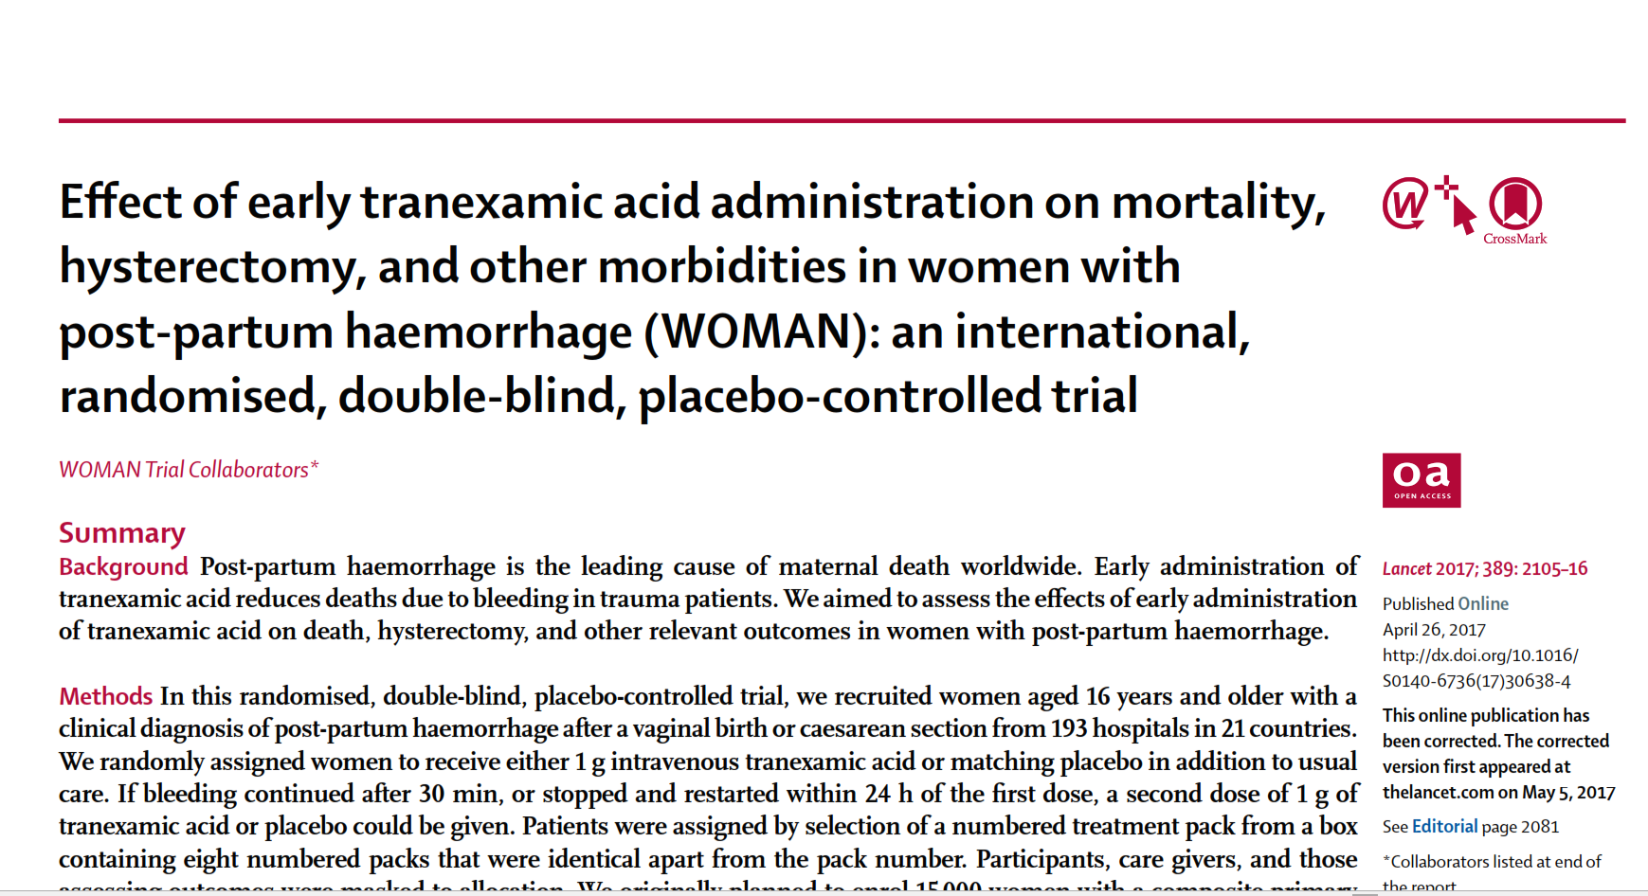
WOMAN TRIAL RESULTS
Conducted in 21 countries, 193 hospitals and recruited 20,060 patients.
Nigeria was the highest contributor with 5,711 patients from 53 hospitals.
Tranexamic acid reduced death by up to 70% when given immediately
No effect was seen if given after 3 hours.
The reduction on death was 30% in this trial
It reduced the need for additional surgical intervention by at least 35%.

Slide 12
EARLY TREATMENT IS ESSENTIAL
Survival benefit decreased by 10% for every 15 min delay until 3 h, after which there was no benefit
Effect of treatment delay on the survival benefit from tranexamic acid

Slide 13
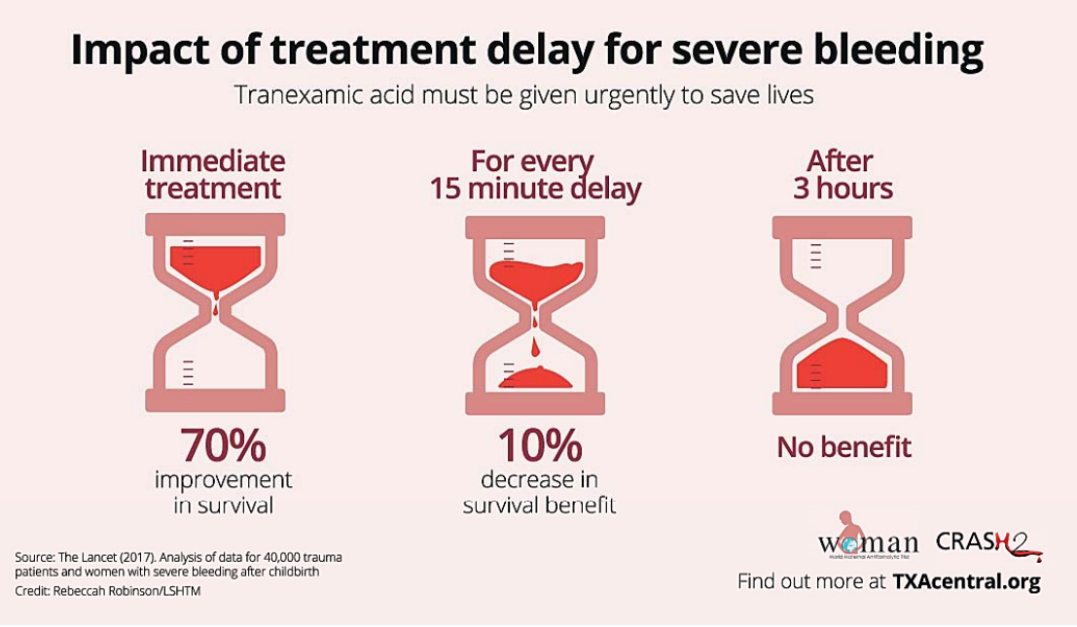
EARLY TREATMENT IS ESSENTIAL
Effect of treatment delay on the survival benefit from tranexamic acid

Slide 14
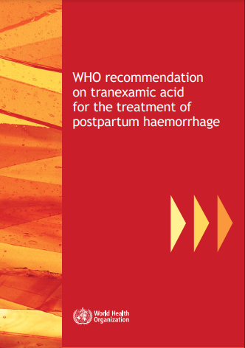
WHO RECOMMENDATIONS
Give 1g TXA intravenously to all women with clinically diagnosed PPH
after caesarean or vaginal birth
alongside other proven interventions
regardless of cause of bleeding
within 3 h of childbirth
Most deaths occur within the first two to three hours after birth, it is critical that TXA is given as soon as possible to save lives
Effect of treatment delay on the survival benefit from tranexamic acid

Slide 15
Lessons Learnt – Implementing the WOMAN trial results

Slide 16
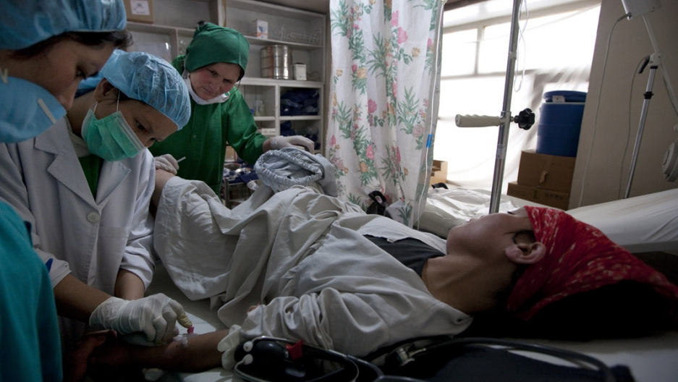
USE OF TXA FOR TREATMENT OF PPH IS LIMITED
  Despite the results being available and being included in WHO and national guidelines since 2017.
  Key issues to address:
    Is TXA available to treat PPH at your hospital and in your labour ward?
    How can we make TXA available at the point of delivery, so it is available when needed?
    How can we ensure that TXA is given in a timely manner when needed?
Effect of treatment delay on the survival benefit from tranexamic acid

Slide 17
TRANEXAMIC ACID FOR THE PREVENTION OF POSTPARTUM BLEEDING IN WOMEN WITH ANAEMIA

Slide 18
FOR SOME WOMEN TREATMENT IS TOO LATE
Bleeding
Other
Number of deaths
Hours since randomisation
The WOMAN Trial Collaborators. Lancet. 2017 ; 389 (10084): 2105-16.
Notes:
Most PPH deaths occur in the first few hours after giving birth

Slide 19
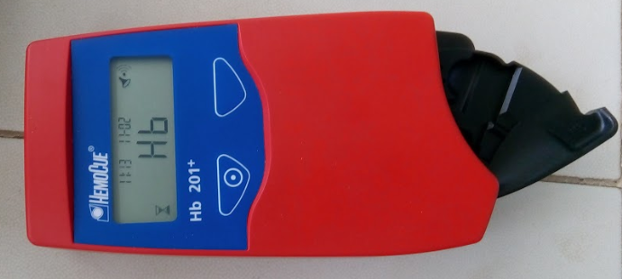
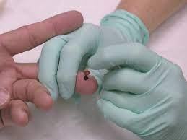
WOMAN-2
Aim
To determine the effect of TXA on postpartum bleeding in women with moderate or severe anaemia
Trial design
  Randomised, double-blind, placebo-controlled trial
  15 000 women with moderate or severe anaemia who are giving birth vaginally in hospitals
  Randomised to receive 1 g of TXA or matching placebo (sodium chloride 0.9%) intravenously immediately and no later than 15 minutes after the umbilical cord is cut or clamped
Inclusion criteria
Women with moderate or severe anaemia (Hb level <100 g/L or PCV <30%), who have given birth vaginally and for who the responsible clinician is substantially uncertain whether to use TXA
Anaemia determined by measuring Hb with the Hemocue analyser

Slide 20
WOMAN-2
Exclusion criteria
Women who are not legally adult (<18 years) and permission not provided by a guardian
Women with a known allergy to TXA or its excipients
Women who develop PPH before umbilical cord is clamped/cut
Outcome measures
Primary outcome
  Clinical diagnosis of PPH at discharge, or at death, or at 24 hours after randomisation, whichever occurs first.
Secondary outcomes
  Maternal health and wellbeing (exercise tolerance test, participant reported outcomes questionnaire)
  Maternal blood loss and its consequences, use of interventions to control bleeding, vascular occlusive events, organ failure, death, length of hospital stay,

Slide 21
TRIAL PROGRESS
Recruitment started on 24/08/2019
First patient in Nigeria recruited on 08/03/2020
13,531 patients randomised worldwide as of 30/06/2023
COUNTRY | SITES | PATIENTS RANDOMISED
Nigeria | 7 | 1,175
Pakistan | 36 | 10,011
Tanzania | 8 | 1,709
Zambia | 1 | 636
TRIAL | 52 | 13,531

Slide 22
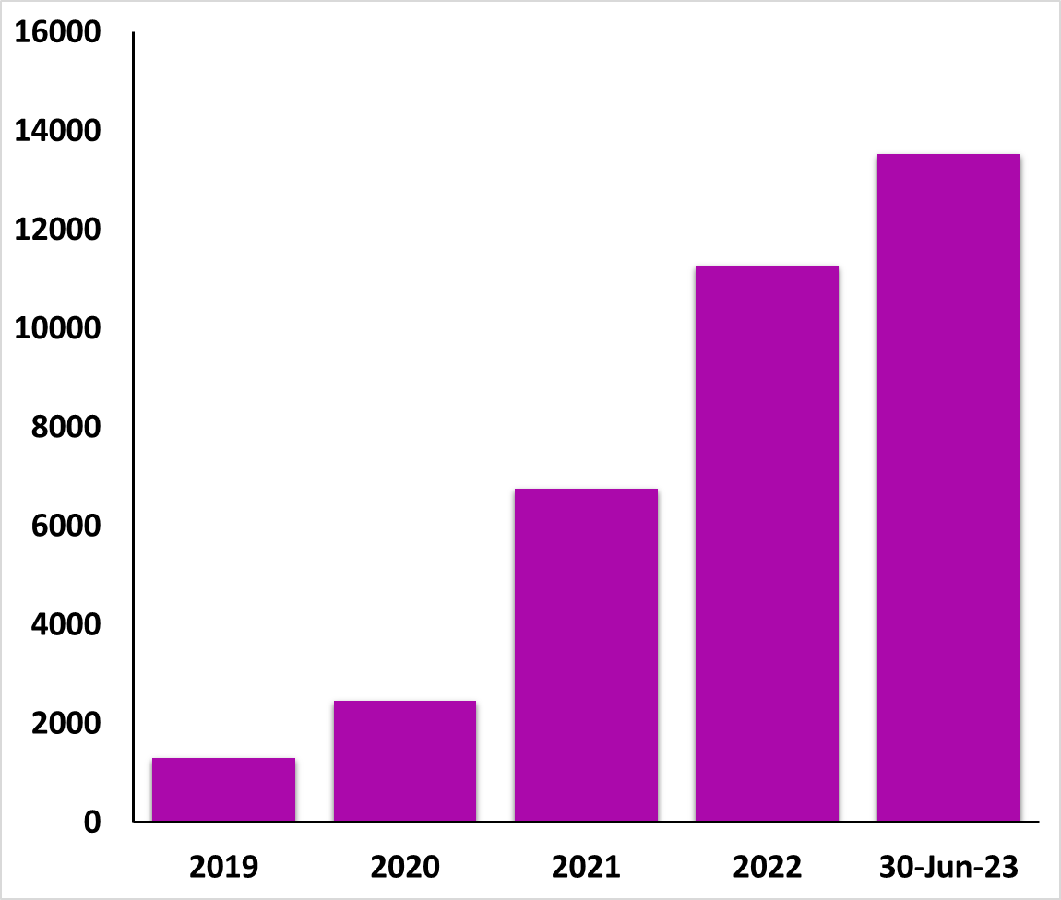
TRIAL PROGRESS AND RECRUITMENT UPDATE
The trial sample size was increased from 10,000 to 15 000 women to ensure that we do not miss a treatment benefit in August 2022.
The trial is recruiting well and is expected to complete recruitment by October 2023
Follow-up is excellent at over 99%

Slide 23
BASELINE CHARACTERISTICS
 | Mean | SD | Range
Age at randomisation (years) | 27.1 | 5.6 | 14 - 50
Haemoglobin (g/dL) | 8.2 | 1.2 | 2.1 - 9.9
Gestational age (weeks) | 37.4 | 2.7 | 17- 45
Number of foetuses (in current pregnancy) | 1 | 0.2 | 1 - 3
Gravida | 3.1 | 2.2 | 1 - 19
Parity (inclusive of current pregnancy) | 2.9 | 2.0 | 1 - 16
Previous caesarean section | 0.1 | 0.2 | 0 - 3

Slide 24
BASELINE CHARACTERISTICS
 | N | %
Previous Postpartum Haemorrhage (PPH)
Yes | 145 | 1.1
No | 13206 | 97.6
Unknown | 180 | 1.3
Antepartum Haemorrhage (APH) in Pregnancy
Yes | 395 | 2.9
No | 13136 | 97.1
APH present at admission (n=342)
Yes | 213 | 46.1
No | 182 | 53.9

Slide 25
BASELINE CHARACTERISTICS
 | N | %
Diabetes
None | 13446 | 99.4
Type 1 | 20 | 0.2
Type 2 | 6 | 0.0
Gestational | 59 | 0.4
Hypertensive disease in pregnancy
None | 12485 | 92.3
Pre-eclampsia | 284 | 2.1
eclampsia | 41 | 0.3
Pregnancy induced hypertension | 673 | 5.0
Pre-existing hypertension | 53 | 0.4
Placenta abnormalities
None | 13098 | 96.9
Abruption | 392 | 2.9
Previa | 34 | 0.3
Accreta | 2 | 0.0

Slide 26

Lessons Learnt - Value of Clinical Diagnosis Of PPH

Slide 27
CLINICAL DIAGNOSIS OF PPH
Is the clinical diagnosis of PPH a good outcome measure for PPH?
Analysis of blinded data from 4,521 WOMAN-2 trial participants to confirm the utility of “Clinical diagnosis of PPH”
Clinical diagnosis of PPH was compared with:
  Measurement of blood loss
  Shock index
  Fatigue test(modified fatigue symptom inventory [MFSI])
  Physical endurance (six-minute walk test) and breathlessness.
Sensitivity and specificity of PPH diagnosis was determined
Brenner et al. Trials. 2023; https://doi.org/10.1186/s13063-022-06140-z
Notes:
Outcome measures in clinical trials of interventions for PPH prevention should facilitate valid and precise estimation of the treatment effect and be important to women.
Because anaemia reduces the oxygen-carrying capacity of the blood, anaemic women cannot tolerate the same volume of blood loss as healthy women. Yet the same blood loss threshold is used to define PPH in all women.
The lack of an established PPH definition in anaemic women means the most appropriate outcome measures for use in clinical trials are open to question.
We used data from the WOMAN-2 trial to examine different definitions of PPH in anaemic women and consider their appropriateness as clinical trial outcome measures.

Slide 28
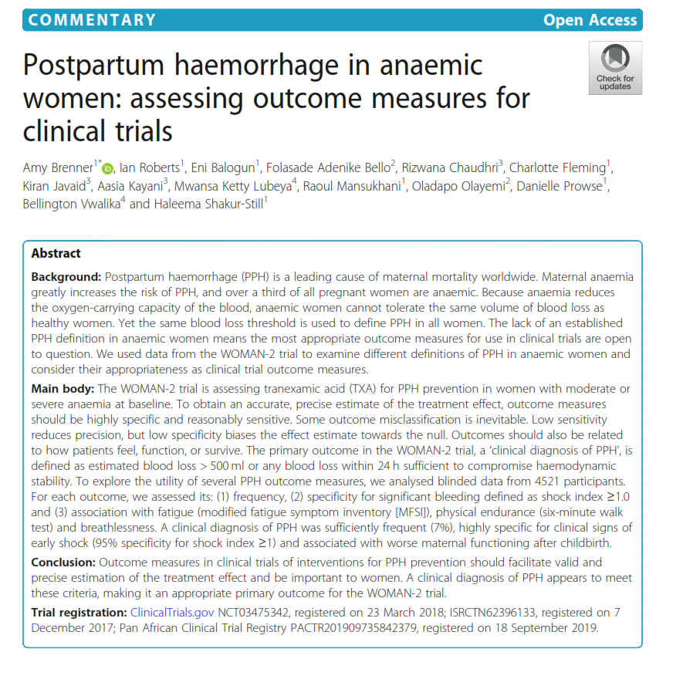
CLINICAL DIAGNOSIS OF PPH
Outcome measures in clinical trials of interventions for PPH prevention should facilitate valid and precise estimation of the treatment effect and be important to women.
A clinical diagnosis of PPH appears to meet these criteria, making it an appropriate primary outcome for the WOMAN-2 trial.
In addition, we learnt of the need to monitor blood loss beyond the delivery Suite
Brenner et al. Trials. 2023; https://doi.org/10.1186/s13063-022-06140-z
Notes:
A clinical diagnosis of PPH, the primary outcome in the WOMAN-2 trial, appears to meet these criteria it was:
Sufficiently frequent,
highly specific for clinical signs of early shock and predictive of maternal functioning after birth.

Slide 29
Lessons Learnt – Maternal anaemia and the risk of PPH

Slide 30
ANAEMIA AND PPH RISK
Does anaemia:
  Increase the risk of PPH?
  Increase the risk of PPH due to uterine atony?
  Is there a dose response?
Prospective cohort analysis of data from 10, 561 WOMAN-2 trial participants
Exposure is maternal haemoglobin measured before birth
Outcome is postpartum haemorrhage
The WOMAN Trial Collaborators. Lancet Glob Health. 2023; https://doi.org/10.1016/S2214-109X(23)00245-0

Slide 31
PREBIRTH HAEMOGLOBIN
N=10561

Slide 32
ESTIMATED BLOOD LOSS FOR MODERATE AND SEVERE ANAEMIA
Moderate anaemia N=8671, severe anaemia N=1714
Notes:
N= 10385. The 170 women with estimated blood loss ≥ 1L are omitted. Six women have a missing estimated blood loss value.

Slide 33
PREBIRTH HAEMOGLOBIN VS PPH RISK

Slide 34
ANAEMIA ALSO INCREASES THE RISK FOR PPH ‘DUE TO ATONY’
WOMAN 2 trial (N=10561)
Data from the WOMAN-2 trial. N= 10561. 742 women had PPH and 495 women had PPH ‘due to atony’.

Slide 35
PREBIRTH HAEMOGLOBIN AND PPH
Risk factors: previous PPH, abnormal placenta, antepartum haemorrhage, infection, multiple pregnancy and primigravida

Slide 36
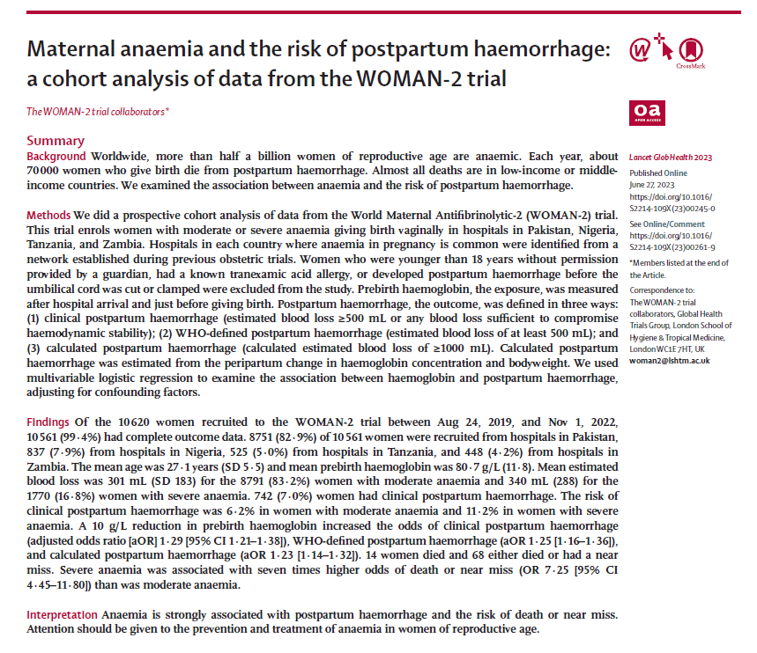
ANAEMIA AND PPH RISK
A 10g/L reduction in haemoglobin is associated with an 23% increased risk of PPH.
Severely anaemic women have twice the risk of PPH compared to moderately anaemic.
Severe anaemia has sevenfold higher odds of death or near miss vs. moderate anaemia.
Anaemia is strongly associated with postpartum haemorrhage and the risk of death or near miss.
Greater attention should be given to the prevention and treatment of anaemia in women of reproductive age.
The WOMAN Trial Collaborators. Lancet Glob Health. 2023; https://doi.org/10.1016/S2214-109X(23)00245-0

Slide 37
Lessons Learnt – Alternative routes of TXA administration

Slide 38

ALTERNATIVE ROUTES OF TXA ADMINISTRATION
  PPH is the leading cause of maternal death in Sub-Saharan Africa
    WHO estimates that there are approximately 67,000 maternal deaths per year in Nigeria, with 1 in 5 deaths due to PPH.
  Many births are not assisted by skilled health personnel who are able to give IV injections.
  If TXA can be given intramuscularly more women are likely to receive the treatment sooner
  Relevant in LMICs where many of the PPH deaths happen before the women reach hospital
Effect of treatment delay on the survival benefit from tranexamic acid

Slide 39
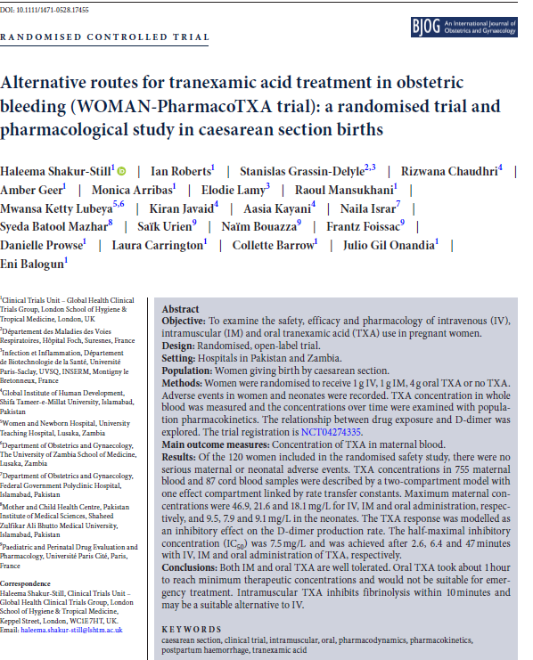
LESSONS LEARNT - ALTERNATIVE ROUTES OF TXA ADMINISTRATION
Both IM and oral TXA are well tolerated.
Oral TXA took about 1 hour to reach minimum therapeutic concentrations and would not be suitable for emergency treatment.
Intramuscular TXA inhibits fibrinolysis within 10 minutes and may be a suitable alternative to IV.
Effect of treatment delay on the survival benefit from tranexamic acid
Shakur-Still H, et al. BJOG. 2023;00:1–10. https://doi.org/10.1111/1471-0528.17455

Slide 40

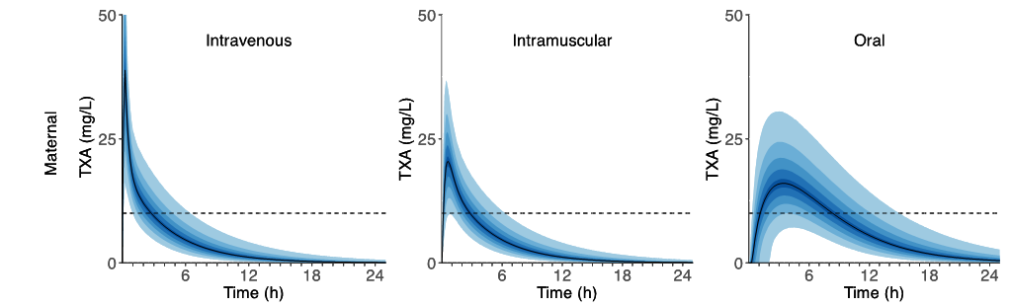
LESSONS LEARNT - ALTERNATIVE ROUTES OF TXA ADMINISTRATION
IM TXA is well tolerated and rapidly absorbed in pregnant women
Shakur-Still H, et al. BJOG. 2023;00:1–10. https://doi.org/10.1111/1471-0528.17455
Notes:
No serious adverse events reported in mothers or neonates, there were no vascular occlusive events or seizures reported.
In pregnant women 1 g of TXA given intramuscularly achieves therapeutic concentration in less than 10 minutes, the time it takes to give the same dose intravenously.
Oral treatment takes about 1 hour to reach therapeutic concentration, it would not be suitable for emergency treatment.
Also, it is possible that there may be fewer side effects with IM TXA than with IV TXA.
Because, peak blood concentrations are lower in the IM route than with the IV route. By avoiding high blood concentrations, the IM route might cause fewer side effects (e.g. nausea, vomiting, dizziness).
A better safety profile would be particularly important when using tranexamic acid for PPH prevention.

Slide 41
WHAT NEXT?
  The WOMAN-2 trial is expected to complete recruitment this year.
  Implementation of the results of the WOMAN Trial is important and will facilitate uptake of the WOMAN-2 trial results if TXA is found to be effective in preventing PPH in women with moderate to severe anaemia.
  How can we ensure that women who deliver outside hospital benefit from TXA?
Effect of treatment delay on the survival benefit from tranexamic acid

Slide 42
ALTERNATIVE ROUTES OF TXA ADMINISTRATION
Give 1g TXA intravenously to all women with clinically diagnosed PPH
after caesarean or vaginal birth
alongside other proven interventions
regardless of cause of bleeding
within 3 h of childbirth
'evaluation of other routes of TXA administration is a research priority'
Effect of treatment delay on the survival benefit from tranexamic acid

Slide 43
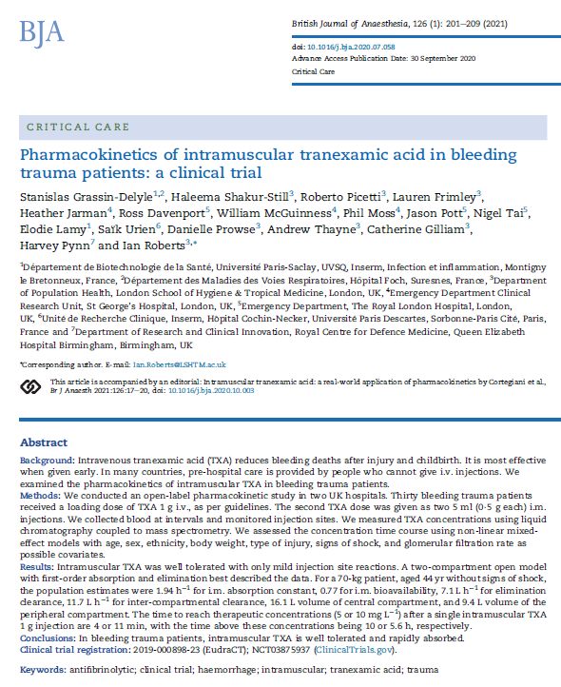
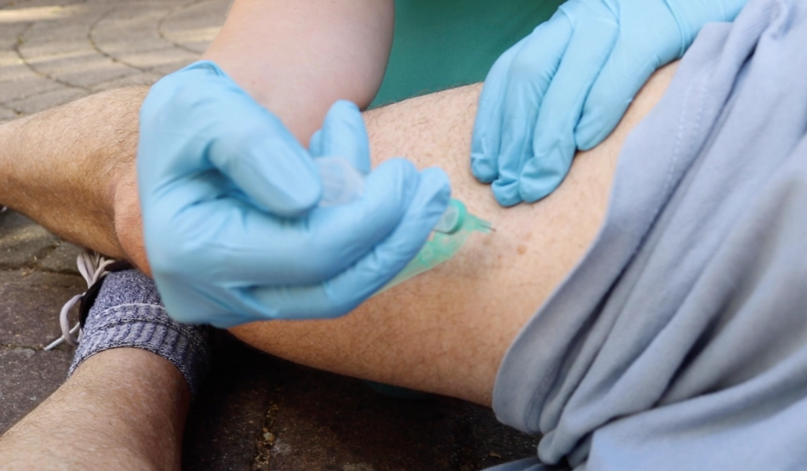
ALTERNATIVE ROUTES OF TXA ADMINISTRATION
IV route is the main barrier to timely TXA treatment for PPH
TXA is well tolerated and rapidly absorbed after IM injection in bleeding trauma victims
Grassin-Delyle S et al. Br J Anaesth. 2021; doi:https://doi.org/10.1016/j.bja.2020.07.058

Slide 44

ALTERNATIVE ROUTES OF TXA ADMINISTRATION
Large randomised clinical trial needed to learn more about the clinical efficacy and safety of the IM route (I’M WOMAN trial)​
Tranexamic acid by the intramuscular or intravenous route for the prevention of postpartum haemorrhage in women at increased risk: a randomised, placebo-controlled trial

Slide 45

I’M WOMAN TRIAL DESIGN
Aim: to assess the effects of IM and IV TXA in women at increased risk of PPH
Design: Randomised, placebo-controlled, three-arm trial
Setting: Hospitals in Africa and Asia
Population: Women giving birth vaginally or by CS, with 1+ risk factors for PPH
Intervention: Intramuscular TXA (1g)
Comparator/control: Intravenous TXA (1g), placebo
Sample size: 30,000 women (IM TXA, IV TXA, placebo)

Slide 46
CONCLUSION
The WOMAN trial provided evidence for use of TXA in treating PPH.
WOMAN 2 Trial seeks to provide evidence on use of TXA to prevent PPH
Implementation of the results of the WOMAN Trial is important and will facilitate uptake of the WOMAN-2 trial results if TXA is found to be effective in preventing PPH in women with moderate to severe anaemia.
Outcome measures in clinical trials of interventions for PPH prevention should facilitate valid and precise estimation of the treatment effect and be important to women. A clinical diagnosis of PPH appears to meet these criteria, making it an appropriate primary outcome for the WOMAN-2 trial.
Anaemia is strongly associated with PPH and the risk of death or near miss. Greater attention should be given to prevention and treatment of anaemia in women of reproductive age.
I’M WOMAN Trial will assess the effects of IM and IV TXA for preventing PPH in women at increased risk

Slide 47
THANK YOU FOR LISTENING
ANY QUESTIONS?

